Slide 1

RRL Group 7
PROJECT
Employee Payroll Management

Slide 2

Group 7 : Team members
SL.No | Id | Name
1 | 2567225 | Biswajit Sahoo
2 | 2566799 | Guttamedi Sucharitha
3 | 2567484 | Likitha D B
4 | 2568980 | Ganguneni Sai Aparna
5 | 2567438 | Chaithra B S
6 | 2566949 | Arindam Mukherjee
7 | 2569337 | Katta Venkata Deepika
8 | 2567879 | Kollam Sathwik Raju

Slide 3

Contents :
Introduction
Objectives
Tools and Technologies
Features
Block Diagram
Advantages
Working of project
JUnit
Postman testing
Conclusion

Slide 4
Introduction
Employee payroll management system is an Internet-based Java application that automates the working of a company or work center that manage and maintain records of the employees
leaves, work,
attendance and
salary.
It is a software solution that automates the process of calculating and distributing employee paychecks.

Slide 5

Objective
The Primary objective of the design is to deliver the requirement as delivered by the feasibility report. There are some objective we kept in mind.
Practically : The system is quite stable and can be operated by the Employees with average intelligence.
Efficiency : We tried to improve accuracy and productivity.

Slide 6
Employee payroll management is the process of calculating and distributing wages to employees. It involves managing various aspects such as time tracking, payroll processing, tax deductions, and compliance. Effective payroll management ensures accurate and timely payment to employees, reducing errors and improving employee satisfaction.

Slide 7
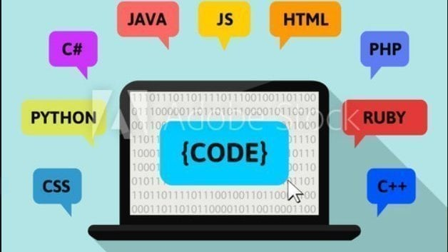
Tools & Languages
Front End
Back End
Eclipse
MySQL
Spring boot
Postman
JUnit
Visual Studio
Angular
HTML
CSS
BOOTSTRAP
Front End
Angular
VS Code

Slide 8

Features
User friendly.
Easy to use. ​It is completely secure.
​This system is easily compatible with most of the web browsers.
​Admin can access all the records .
Store the end-end data of employees & Admins.

Slide 9

Block Diagram
Employee Management
Work schedule Management
Salary Management
Payroll Management System
LLeave Management
Registration Management
LOGIN Management

Slide 10


Advantages
Helps the admin easy way to access the employee data
The information related to employee can be added and removed easily
Store the end-to-end data of the employees
Helps the employee easy way to access their data

Slide 11
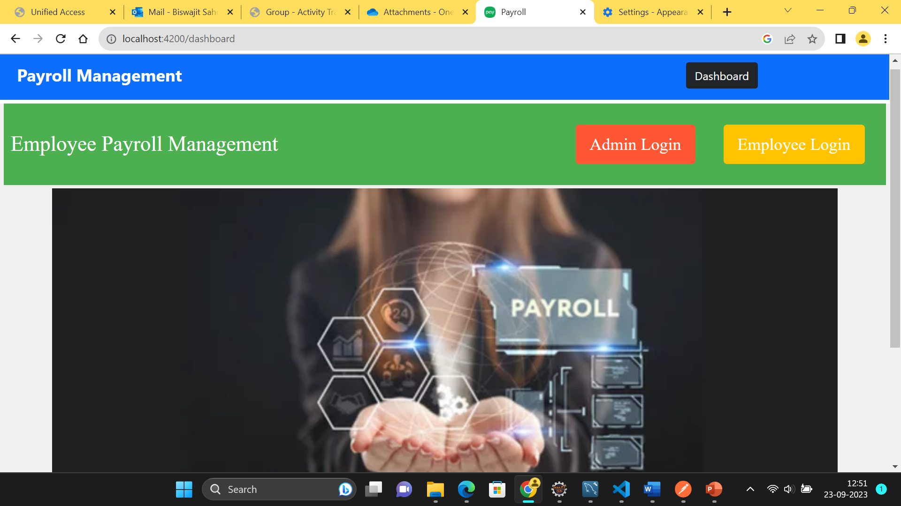
Dashboard

Slide 12

(Admin Operations)

Slide 13
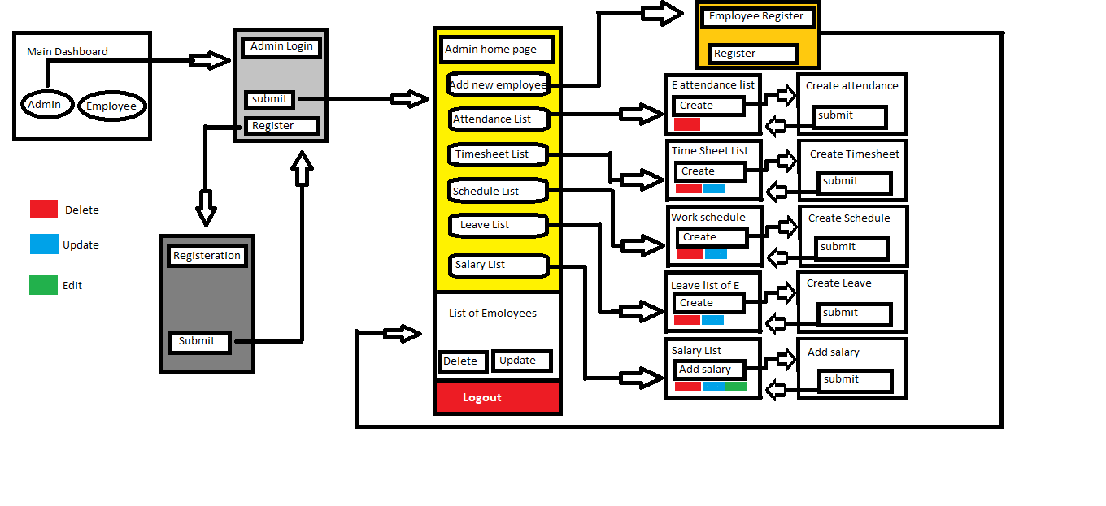
Admin Flow

Slide 14
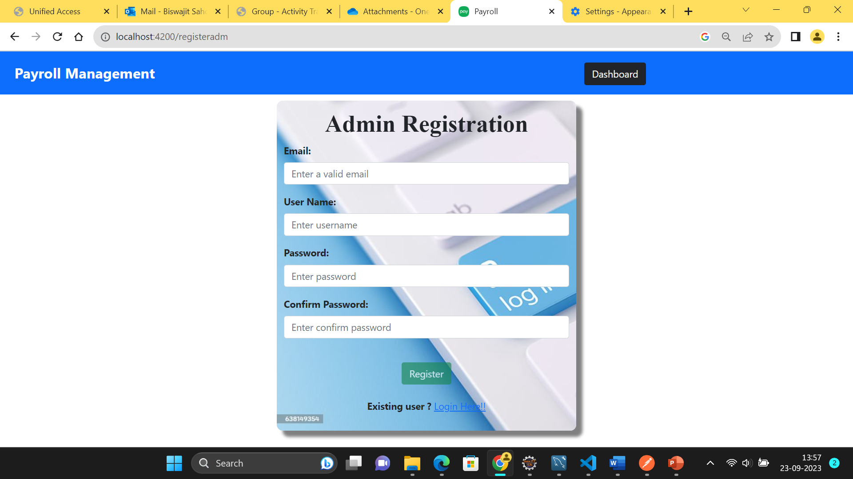
Admin Registration

Slide 15
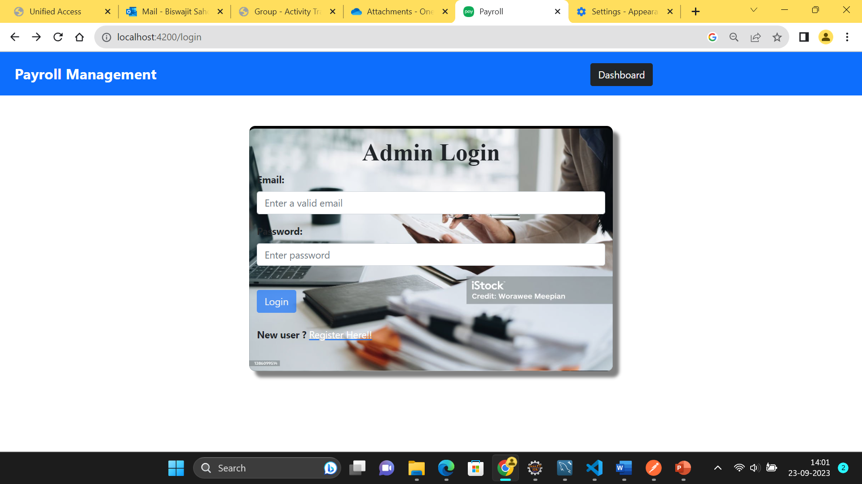
Admin Login

Slide 16

Admin Dashboard
In the admin dashboard, there are 6 components which perform respective functionality,they are:
Add new employee
Attendance list
Timesheet list
Work schedule list
Leave list
Salary list

Slide 17
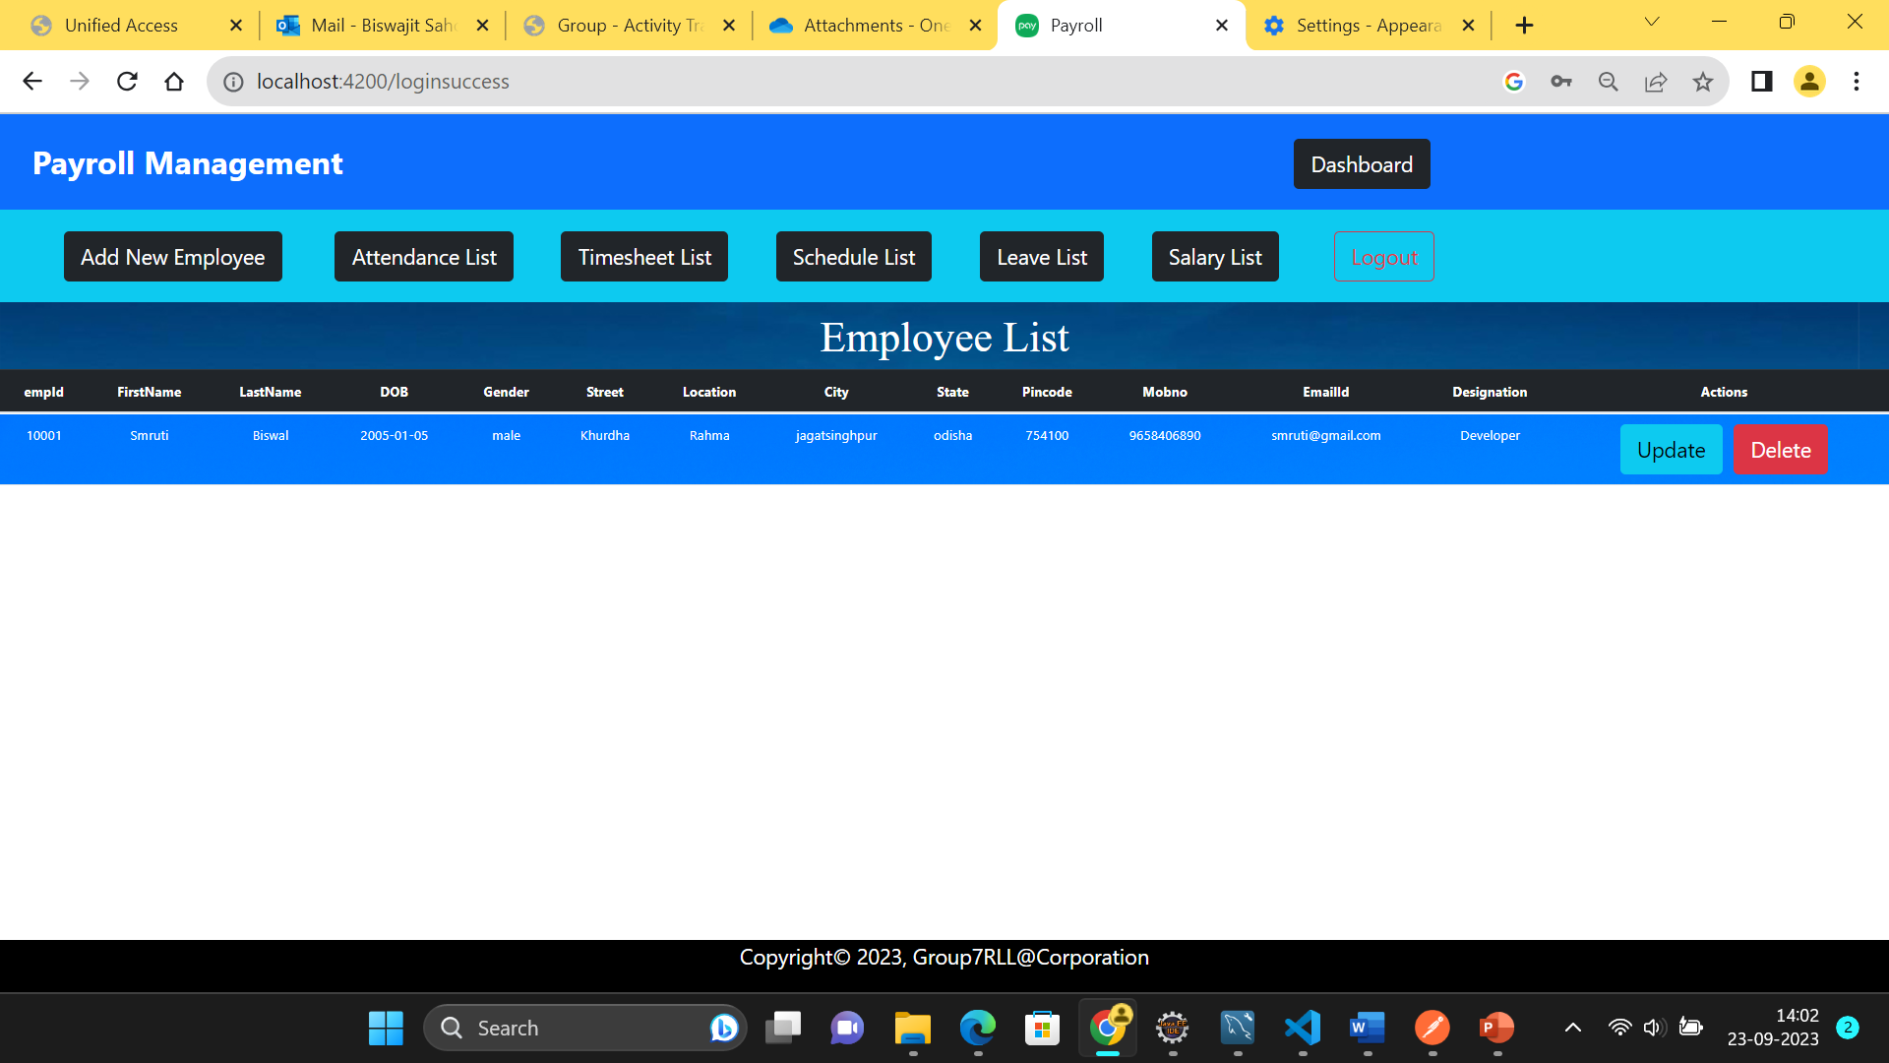
Admin Dashboard

Slide 18
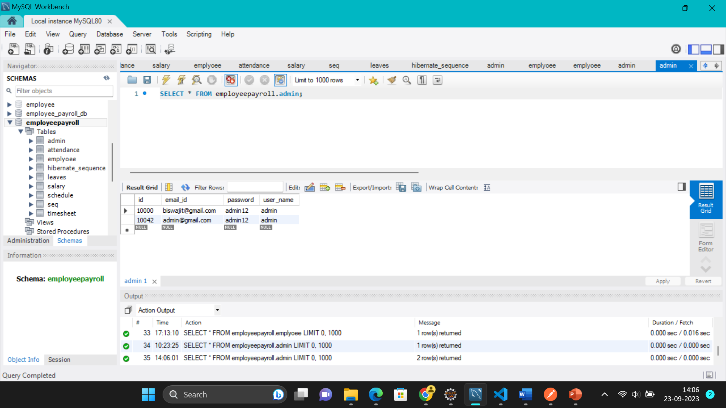
Admin database table

Slide 19
Admin APIs
HTTP methods | URL | Operation
POST | http://localhost:8085/register | To register the admin details
POST | http://localhost:8085/login | To login the admin

Slide 20
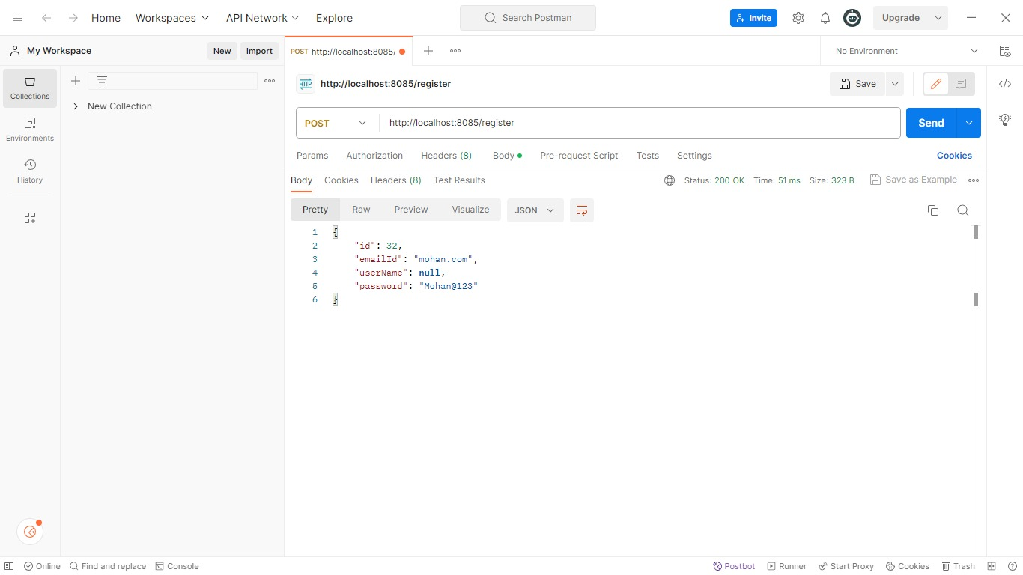

Slide 21
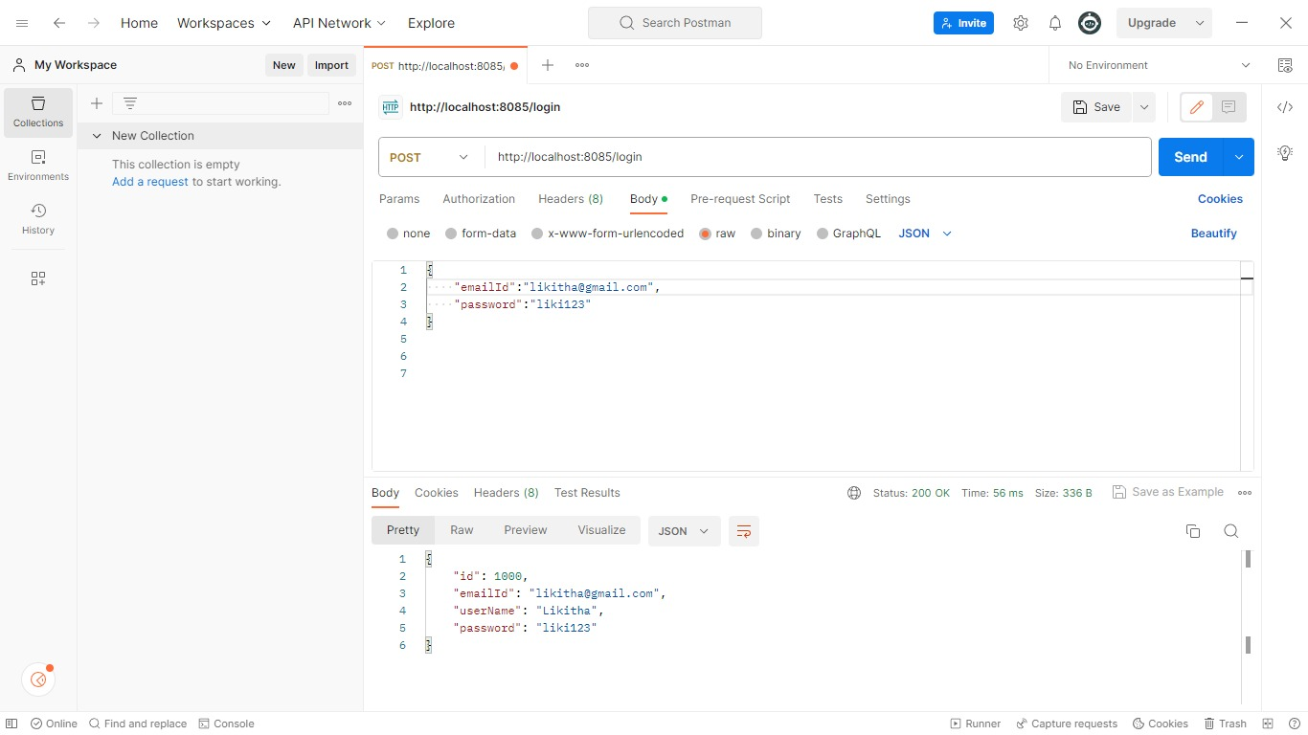

Slide 22
(Employee Operations)

Slide 23
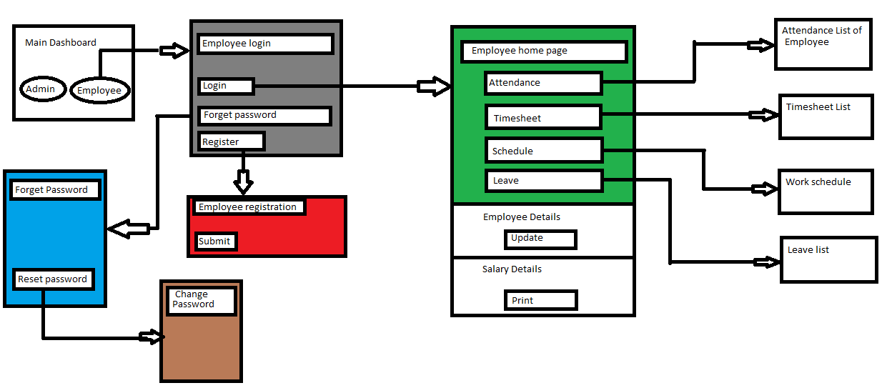
Employee Flow

Slide 24
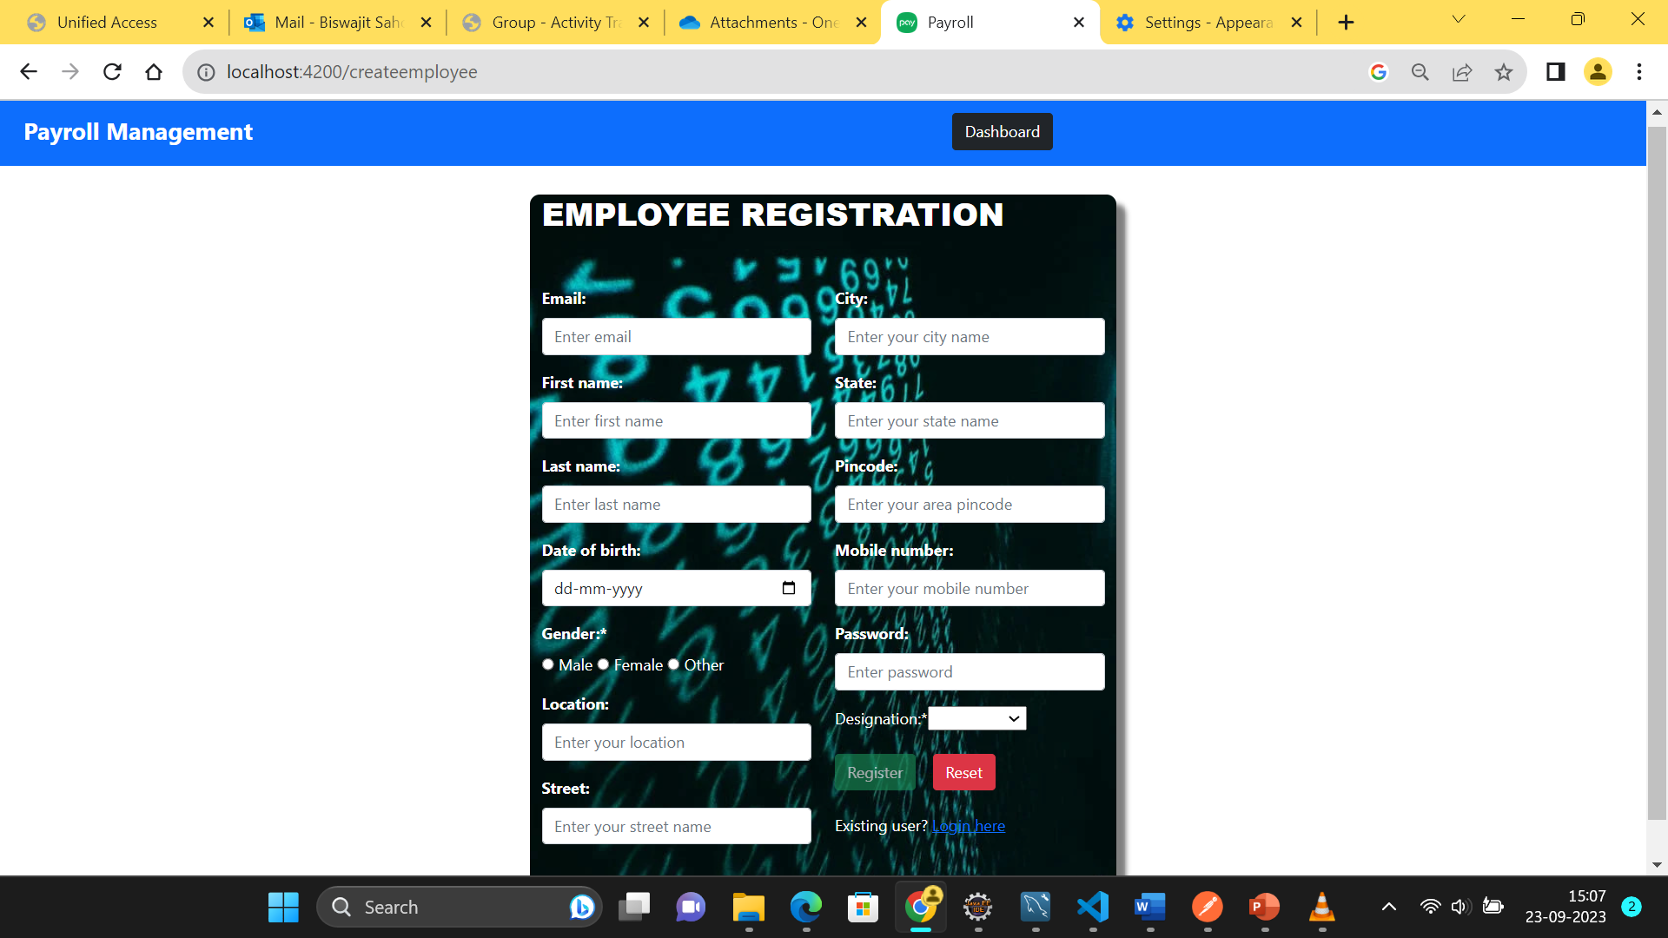
Adding new employee from Admin side

Slide 25

Employee Dashboard
After successful login of employee, there will be a dashboard with 5 main components that can perform respective functionality.
They are:
Salary details
Attendance
Timesheet
Schedule
Leave

Slide 26
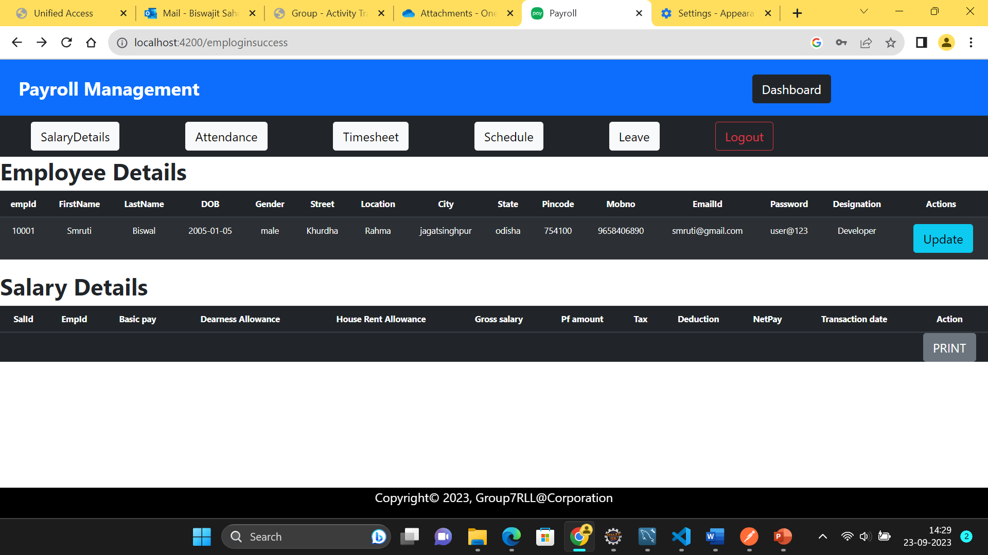
Employee Dashboard

Slide 27
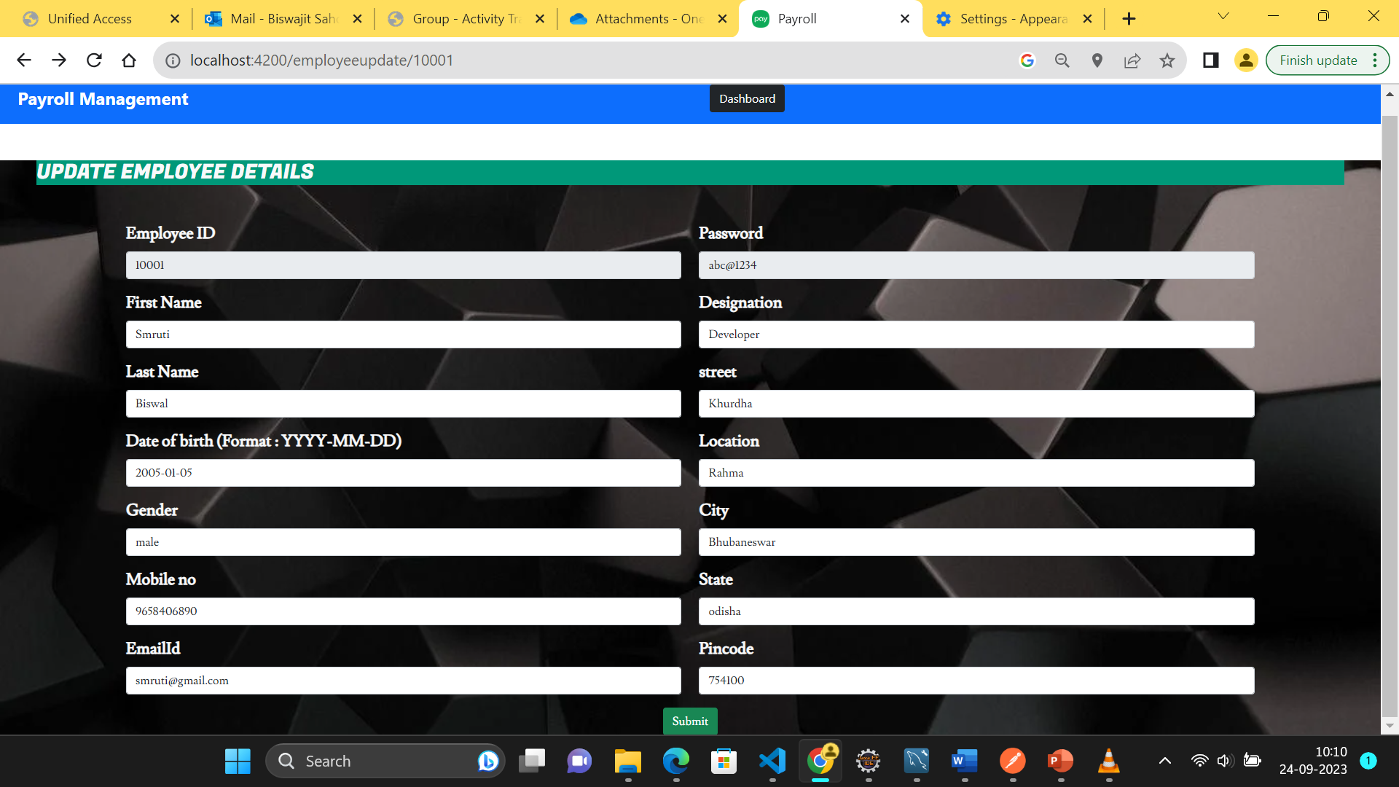
Update Employee Details

Slide 28
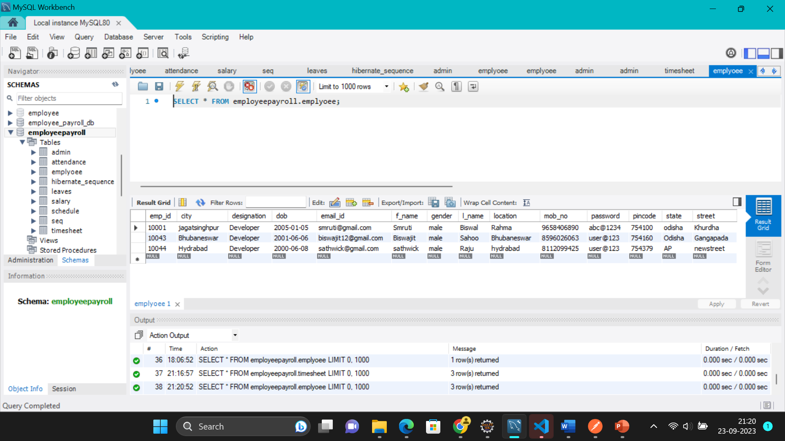
Employee Table In Database

Slide 29
Employee APIs
HTTP methods | URL | Operation
GET | http://localhost:8085/employeepayroll/ad/admins | To retrieve all the employees
POST | http://localhost:8085/employeepayroll/ad/admins | To create/register the new employee
GET | http://localhost:8085/employeepayroll/ad/{empId} | To get the specific employee details
PUT | http://localhost:8085/employeepayroll/ad/{empId} | To update the specific employee details
DELETE | http://localhost:8085/employeepayroll/ad/{empId} | To delete the specific employee details

Slide 30
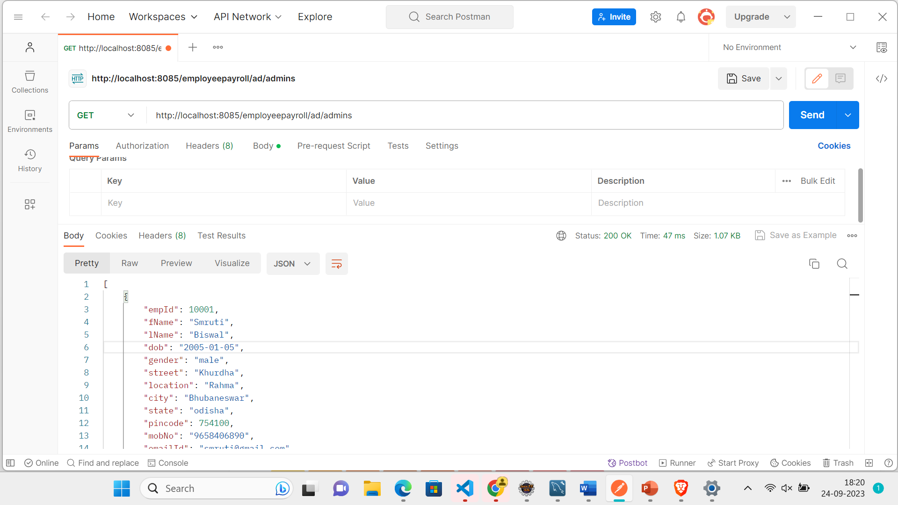

Slide 31
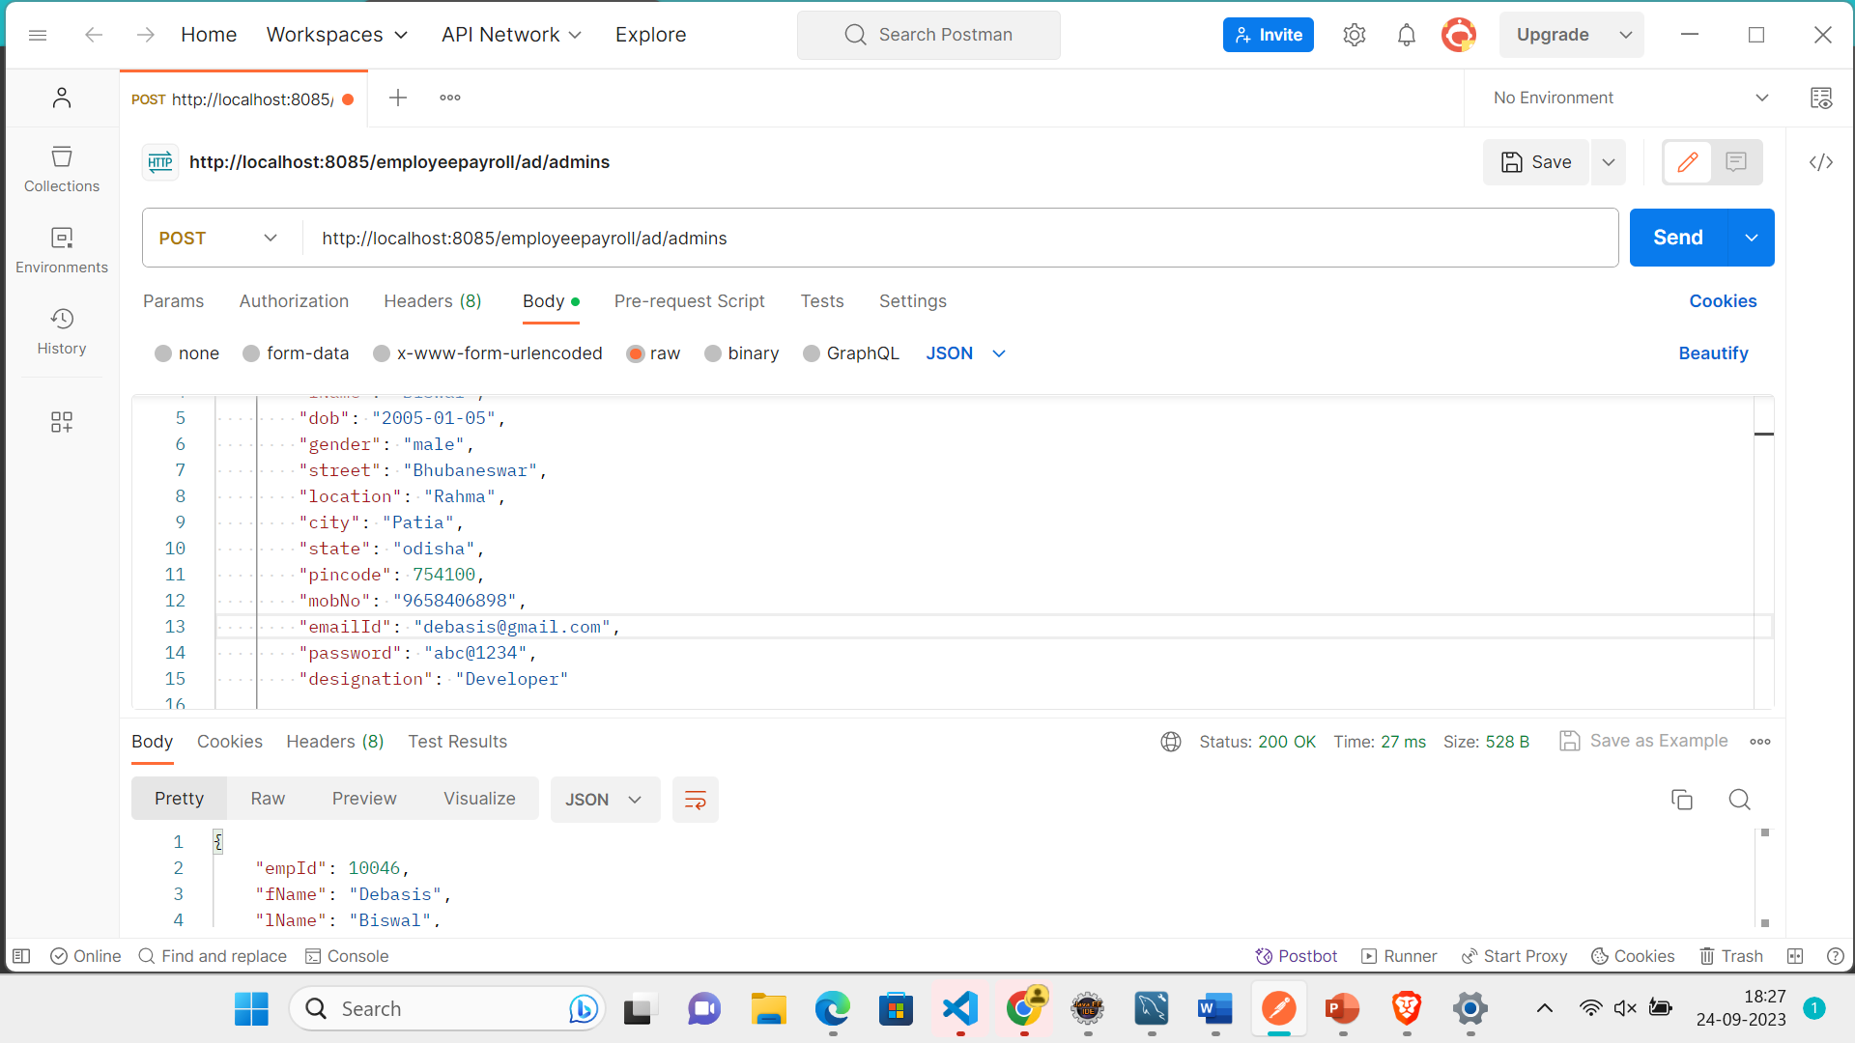

Slide 32
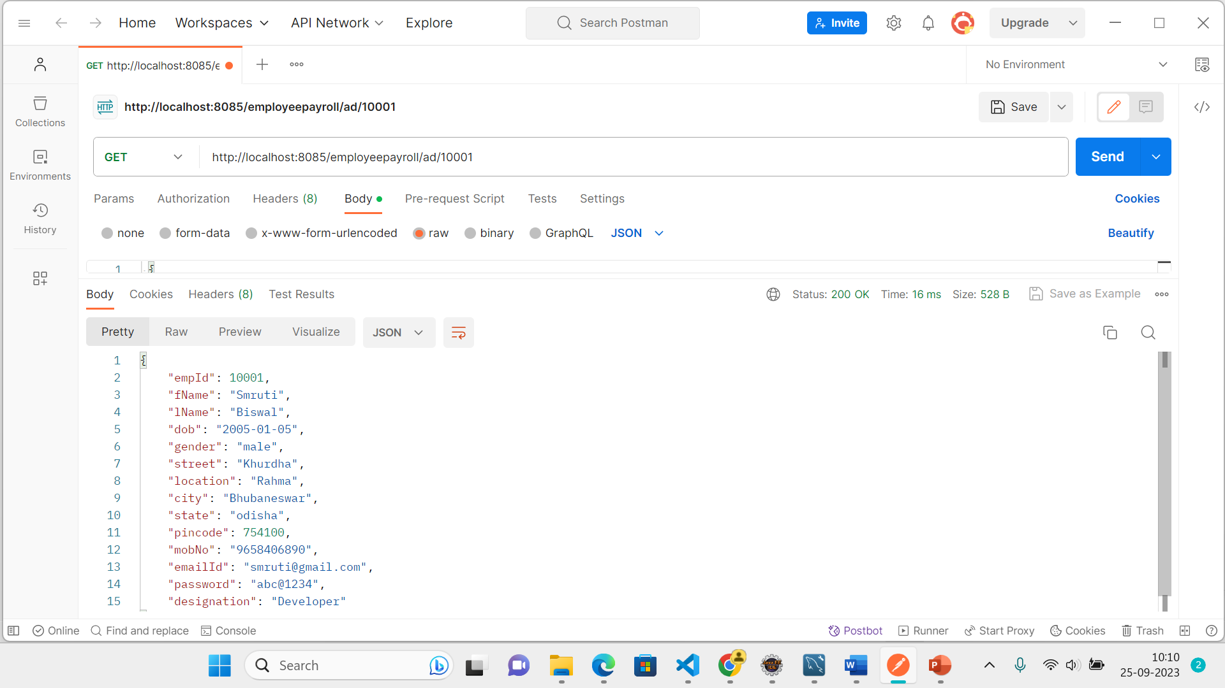

Slide 33
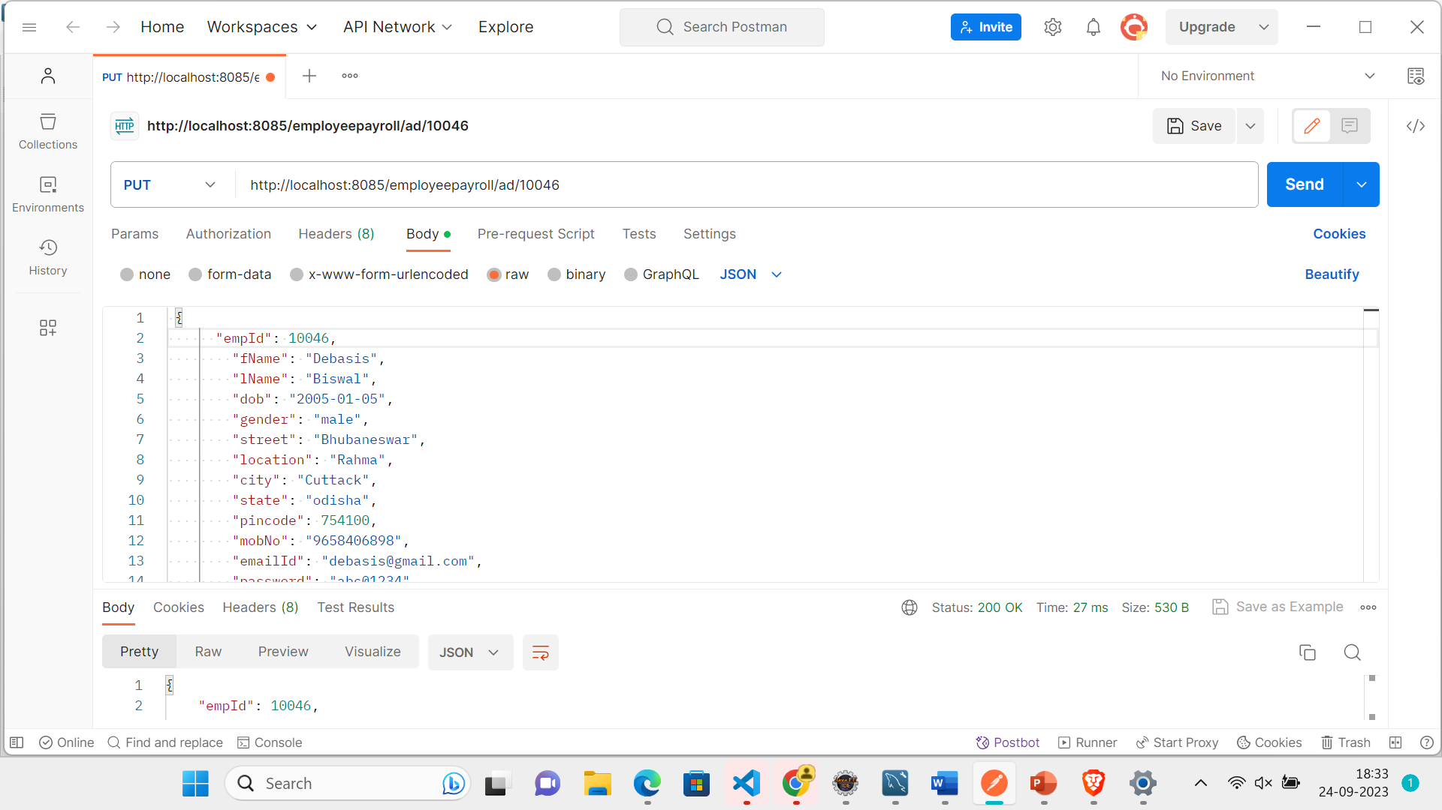

Slide 34
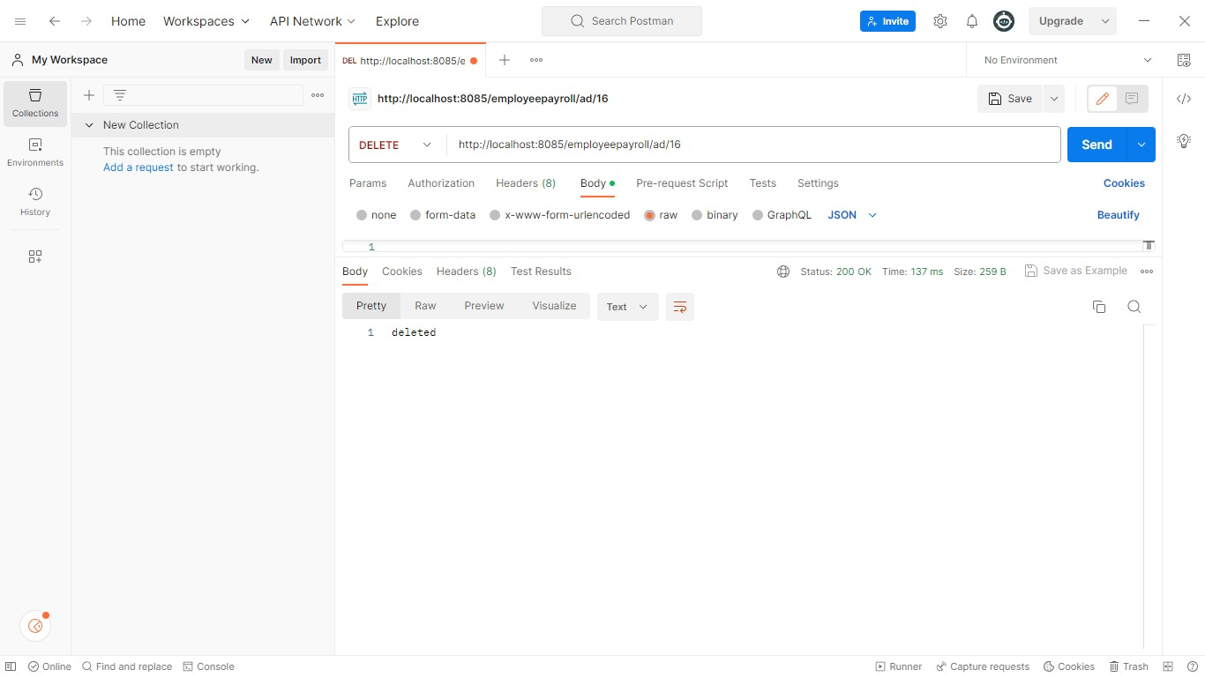

Slide 35

Employee Login ,Registration and Forgot Password

Slide 36
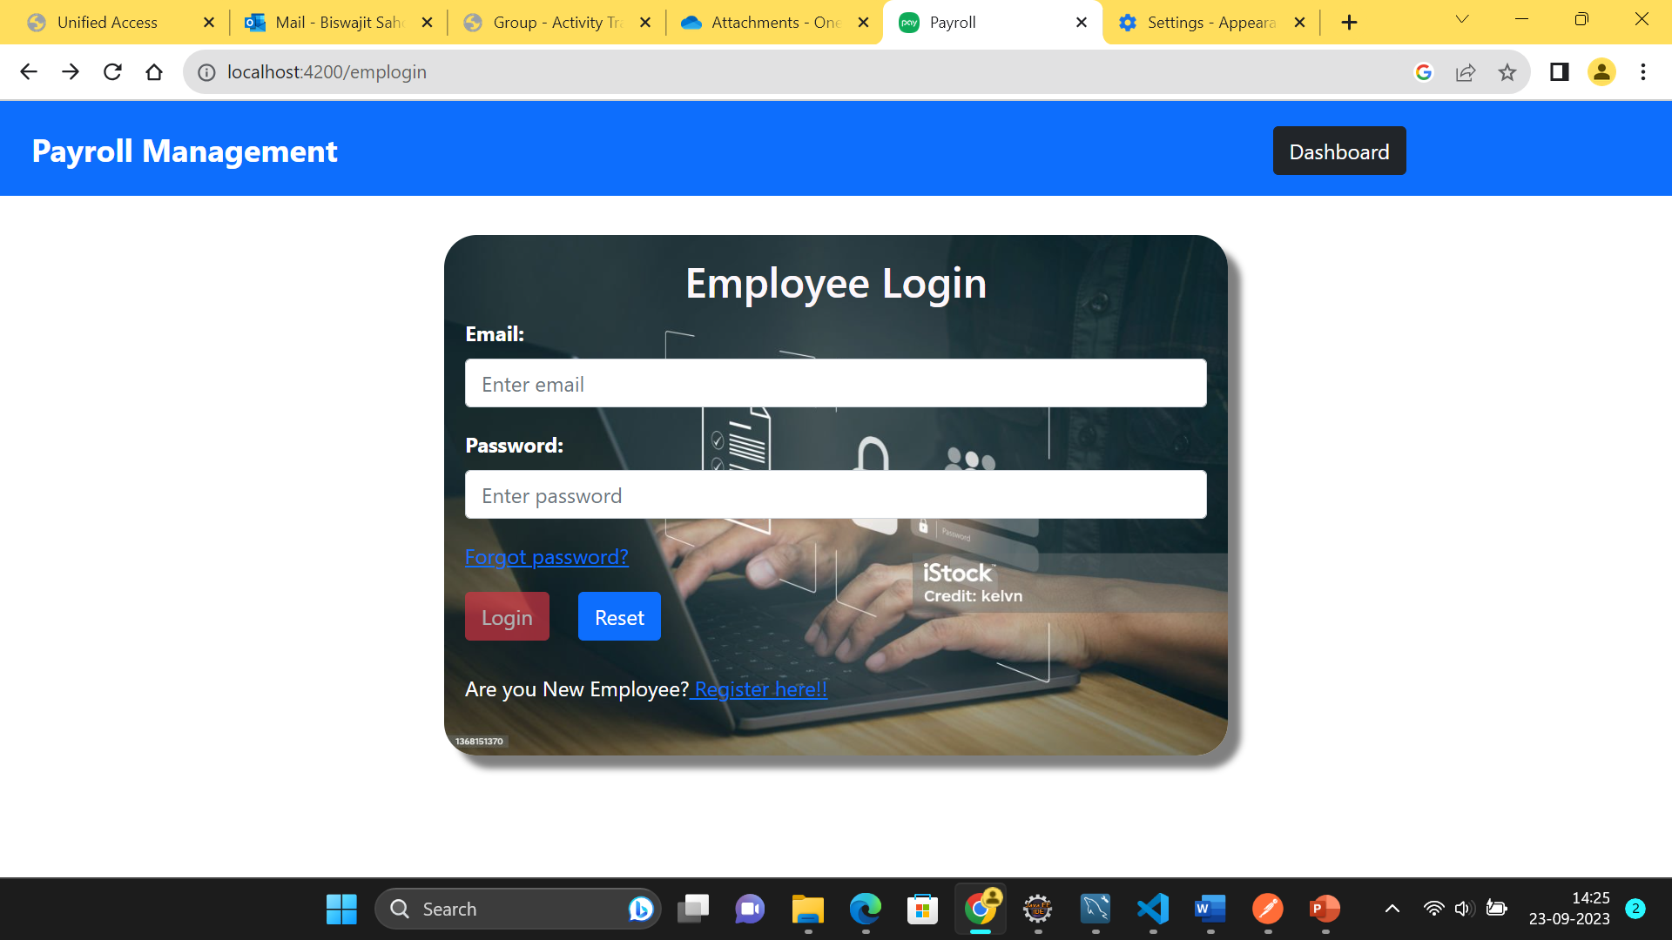
Employee Login

Slide 37
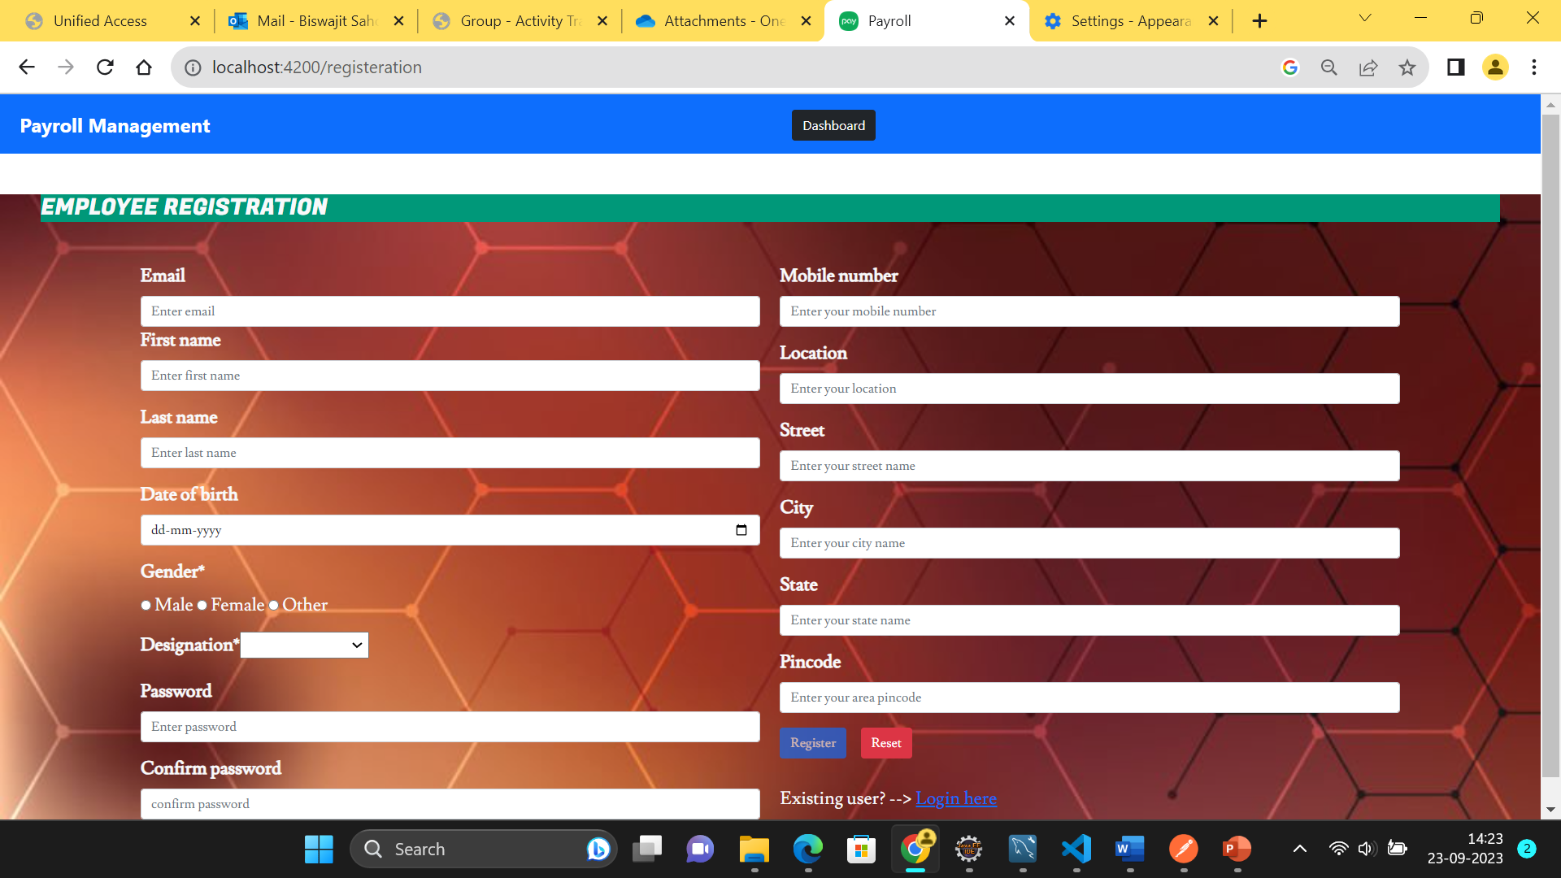
Employee Registration

Slide 38
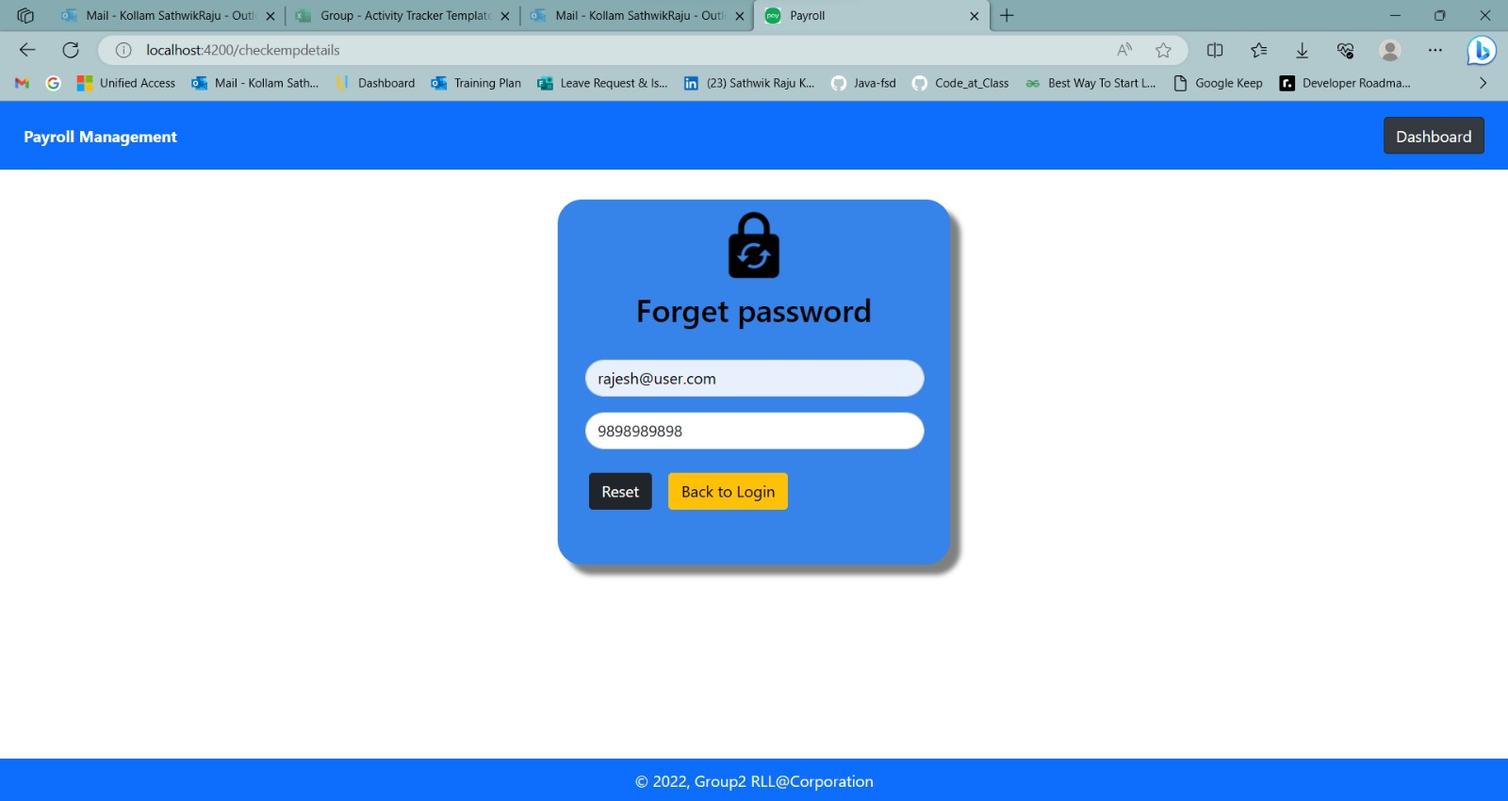

Slide 39
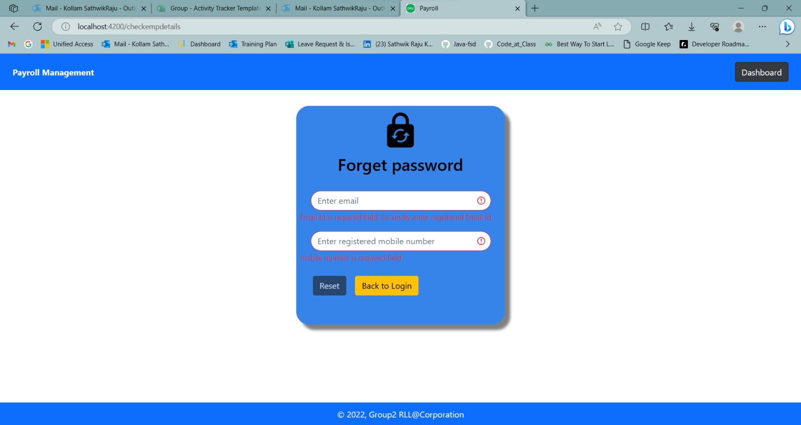

Slide 40
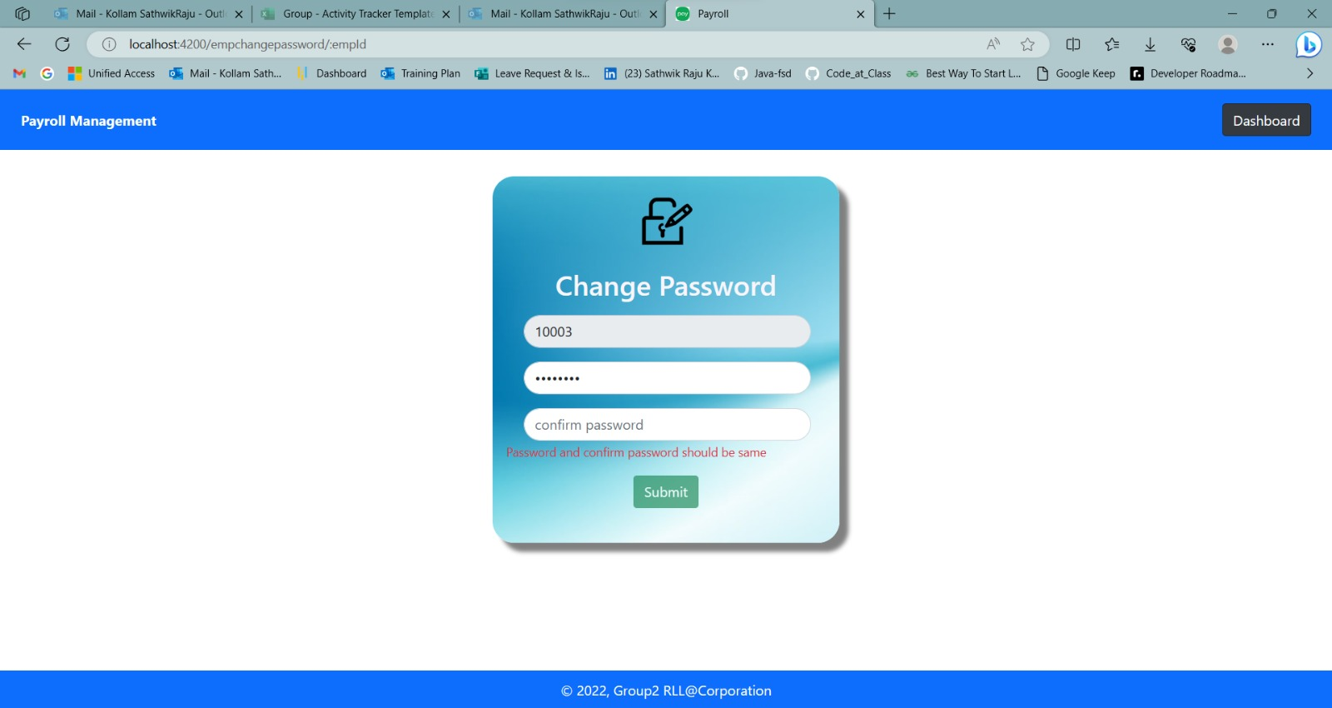

Slide 41
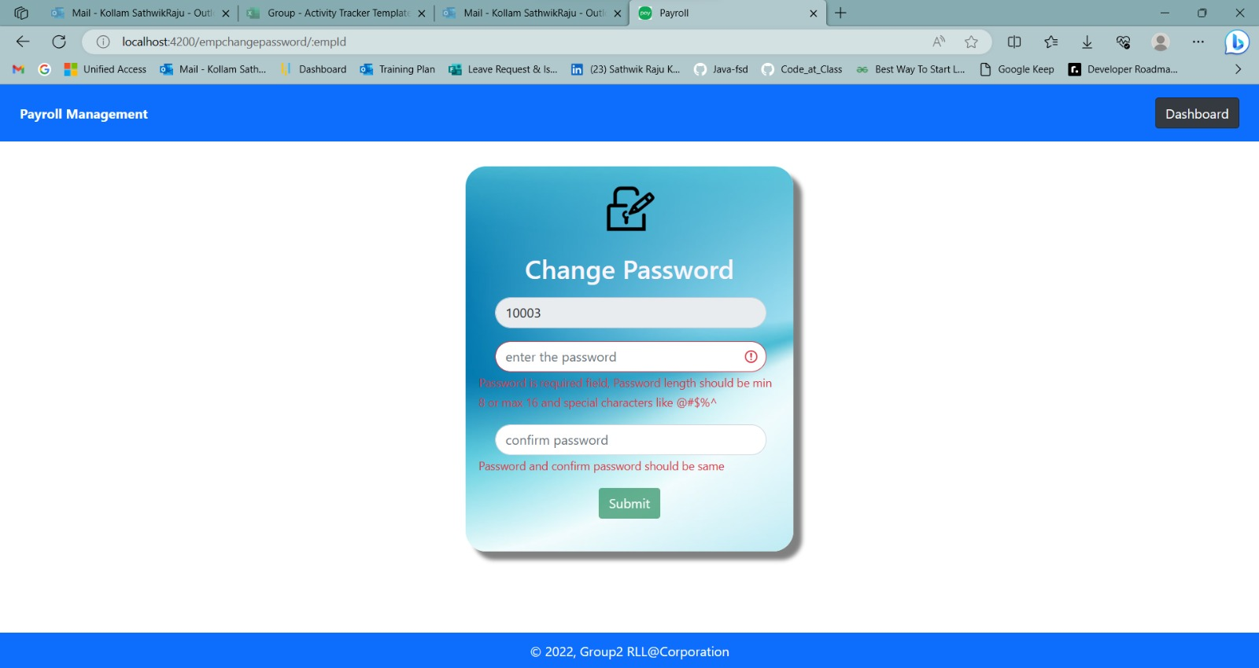

Slide 42
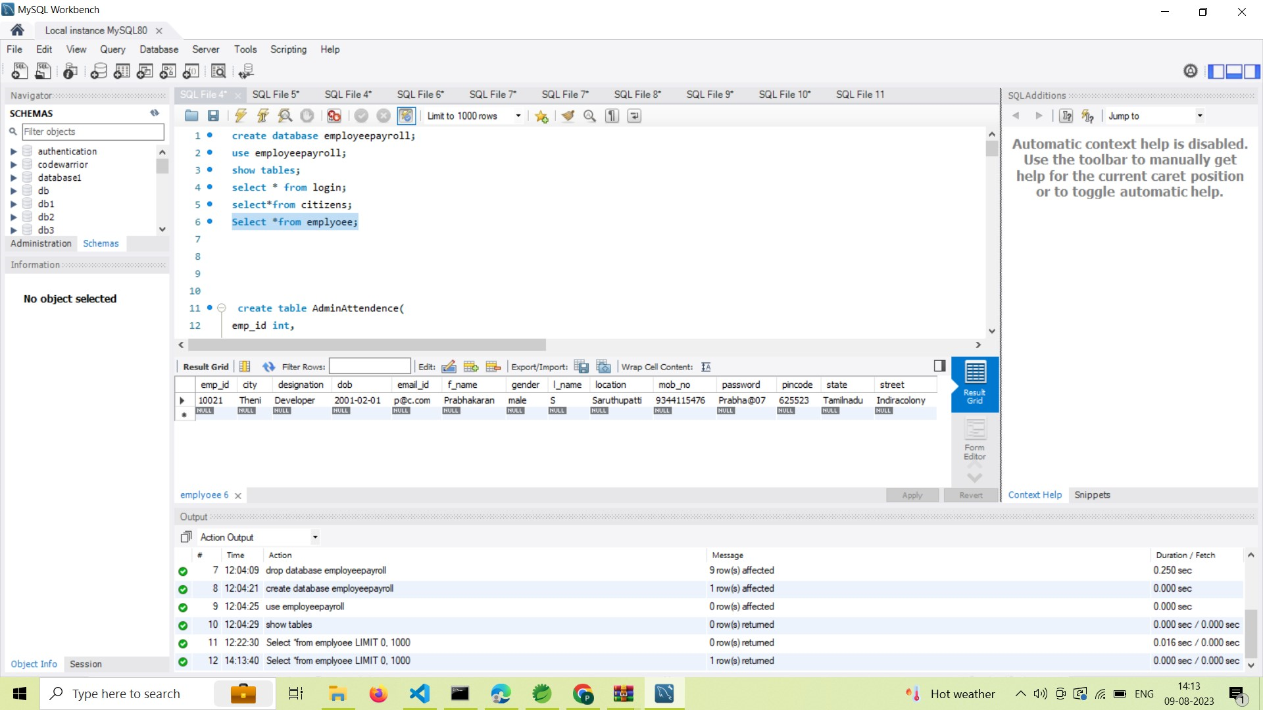

Slide 43
Forgotpassword Employee APIs
HTTP methods | URL | Operation
POST | http://localhost:8085/employees | To register the employee in employee side
POST | http://localhost:8085/employees/login | To login the employee in the employee side
PUT | http://localhost:8085/forgotpassword | To give the registered email and mobile number and to reset the password

Slide 44
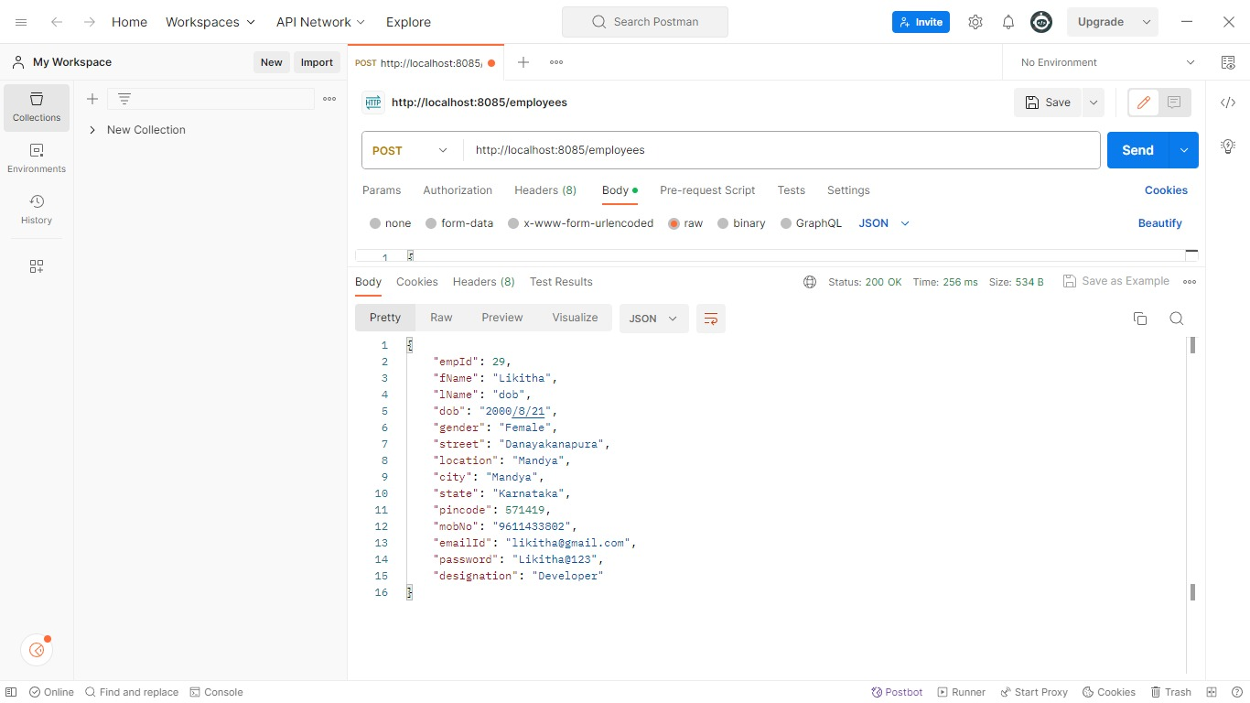

Slide 45
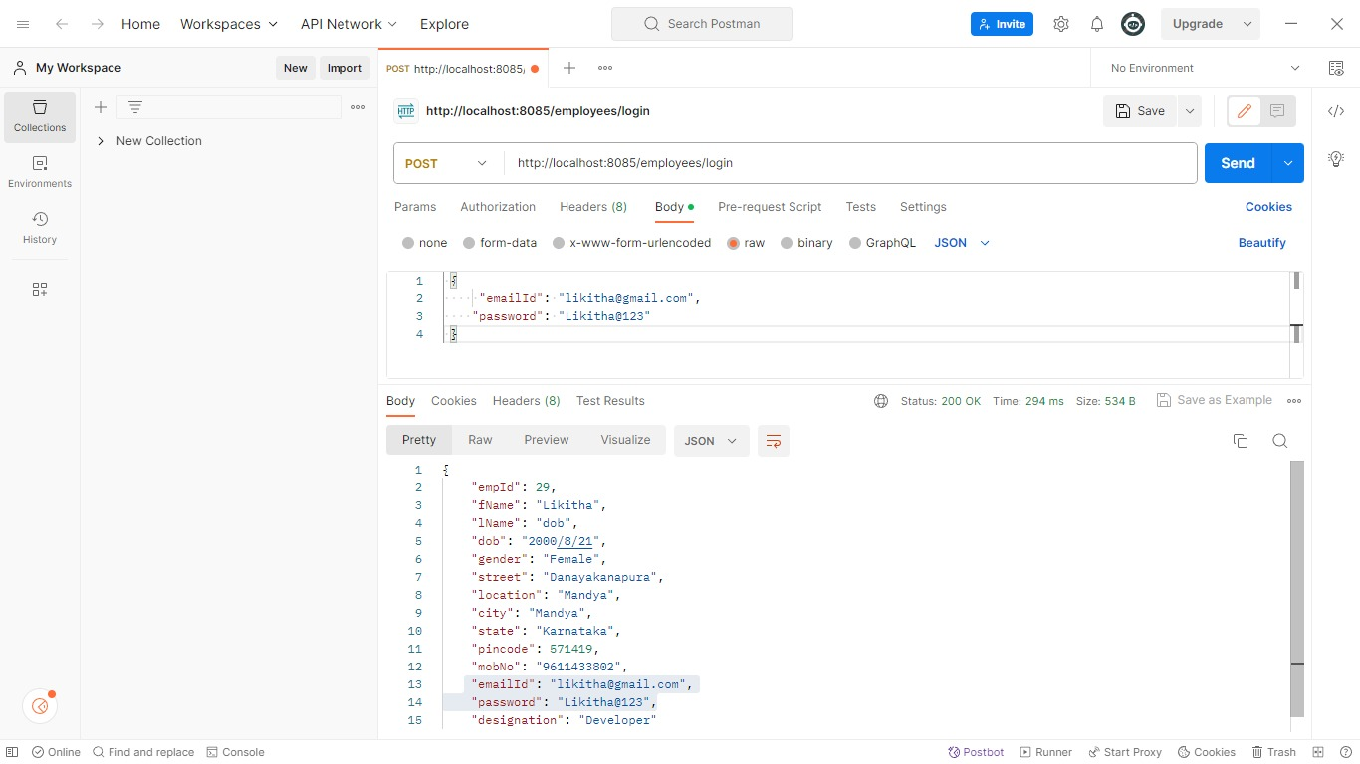

Slide 46
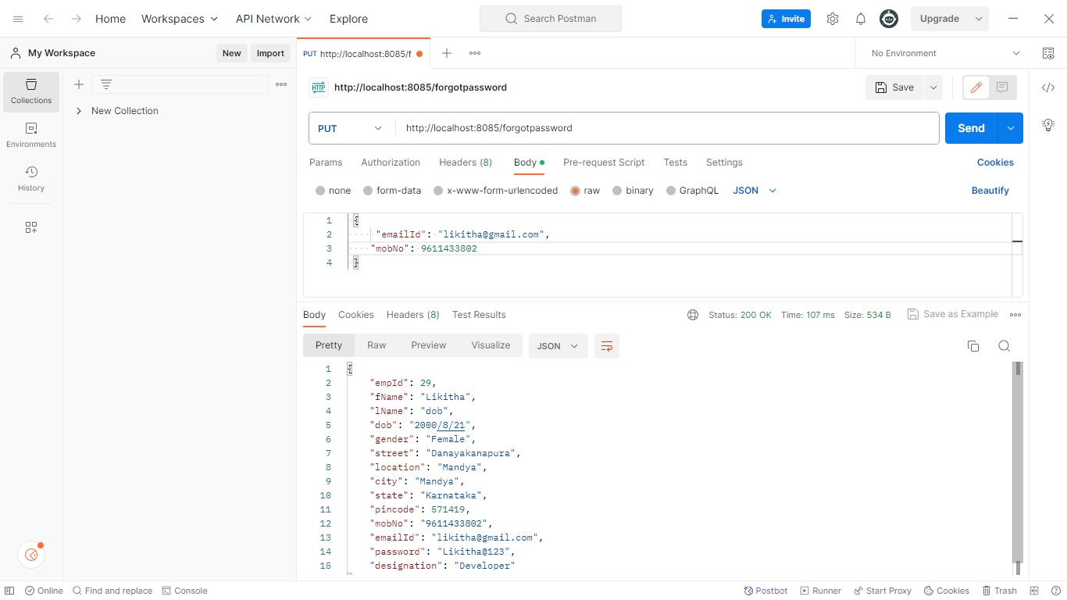

Slide 47

ATTENDANCE

Slide 48
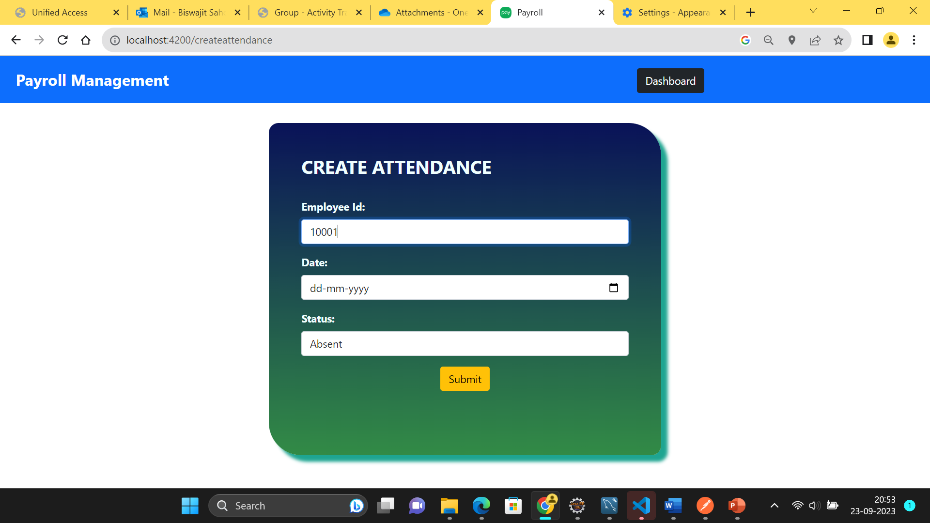
Create Attendance

Slide 49
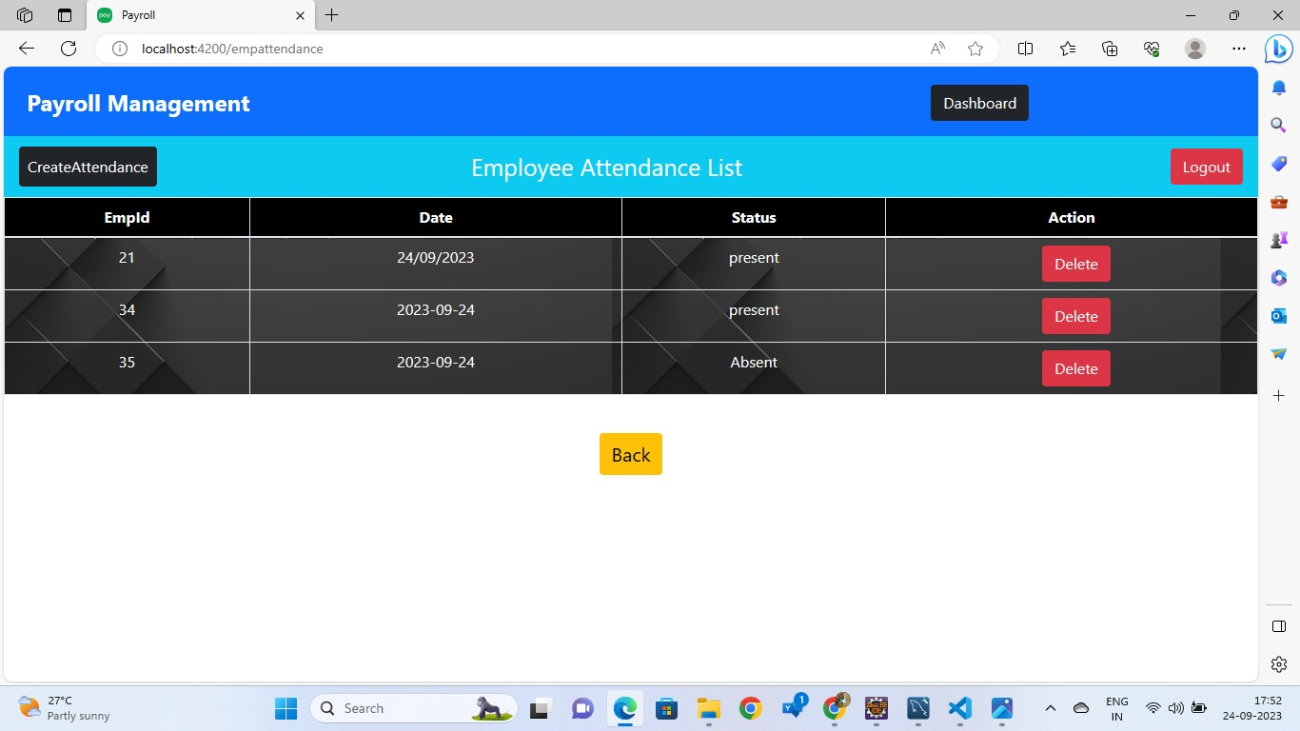
Employee Attendance List

Slide 50
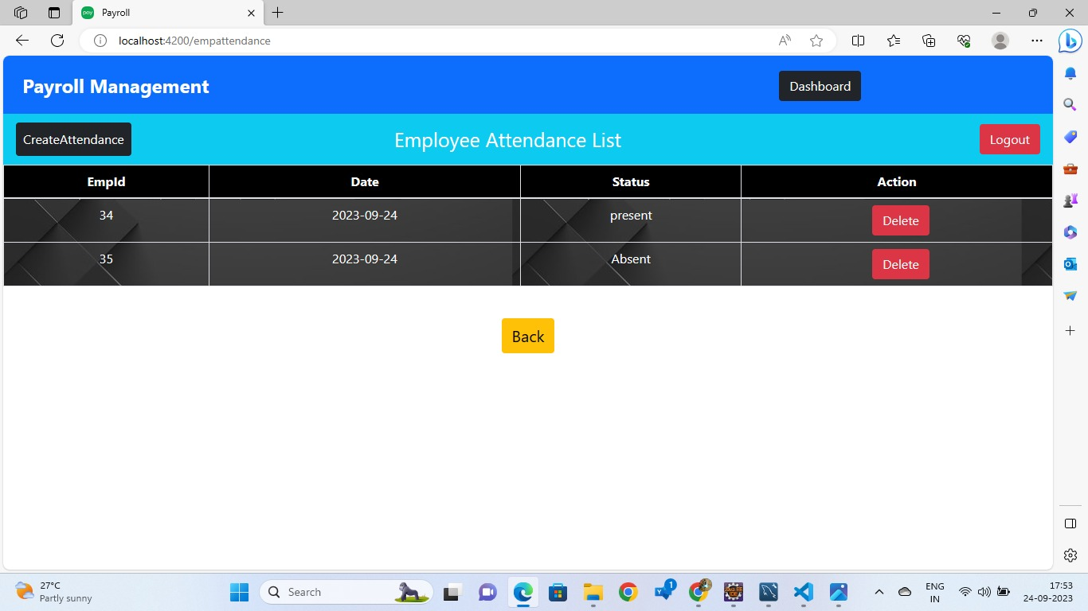

Slide 51
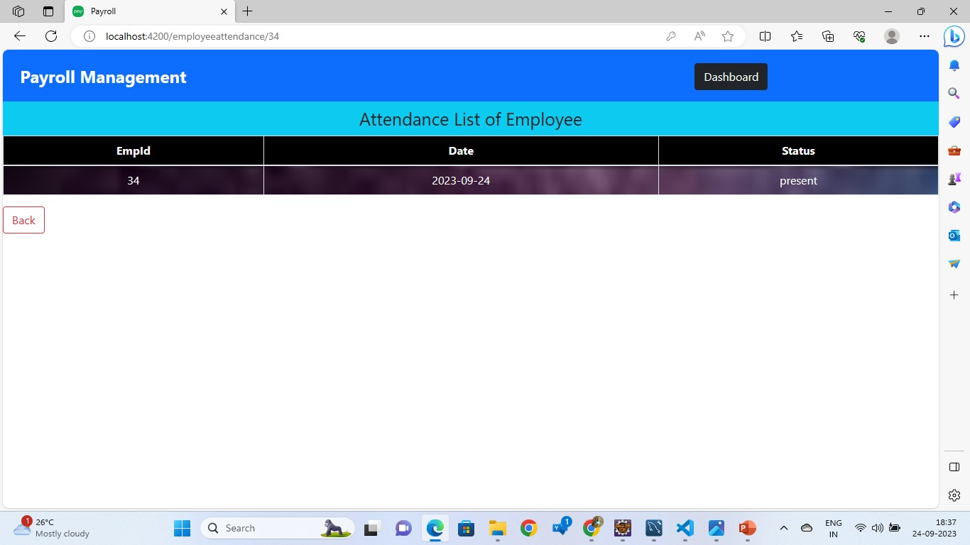
Attendance Record of Particular Employee

Slide 52
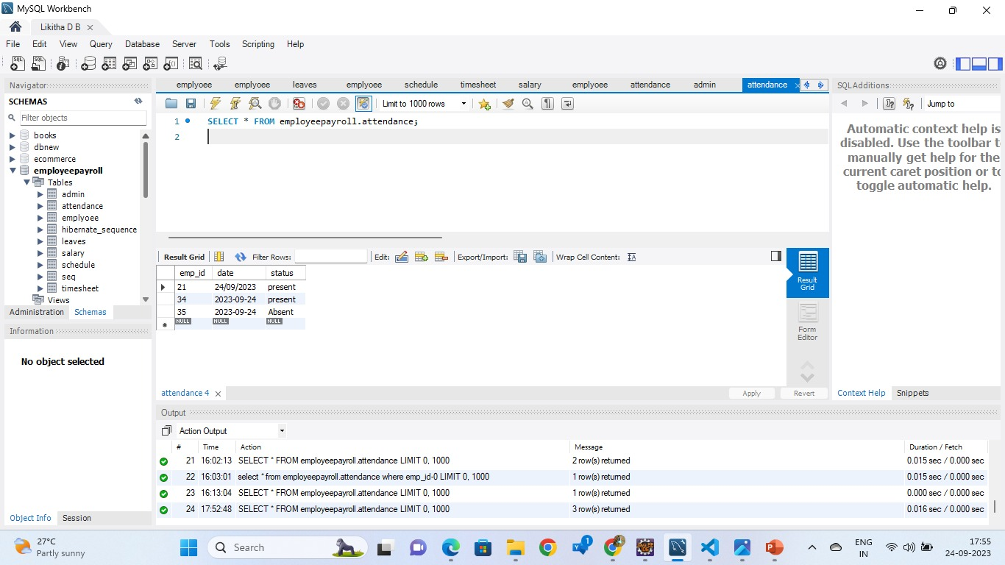
Attendance Table In Database

Slide 53
Attendance APIs
HTTP methods | URL | Operation
GET | http://localhost:8085/employeepayroll/attend/{empid} | To get the attendance of particular employee
GET | http://localhost:8085/employeepayroll/attend/attendances | To get the attendances of all the employees
POST | http://localhost:8085/employeepayroll/attend/attendances | To create the attendance of employee
DELETE | http://localhost:8085/employeepayroll/attend/attendances/{empid} | To delete the attendance of particular employee

Slide 54
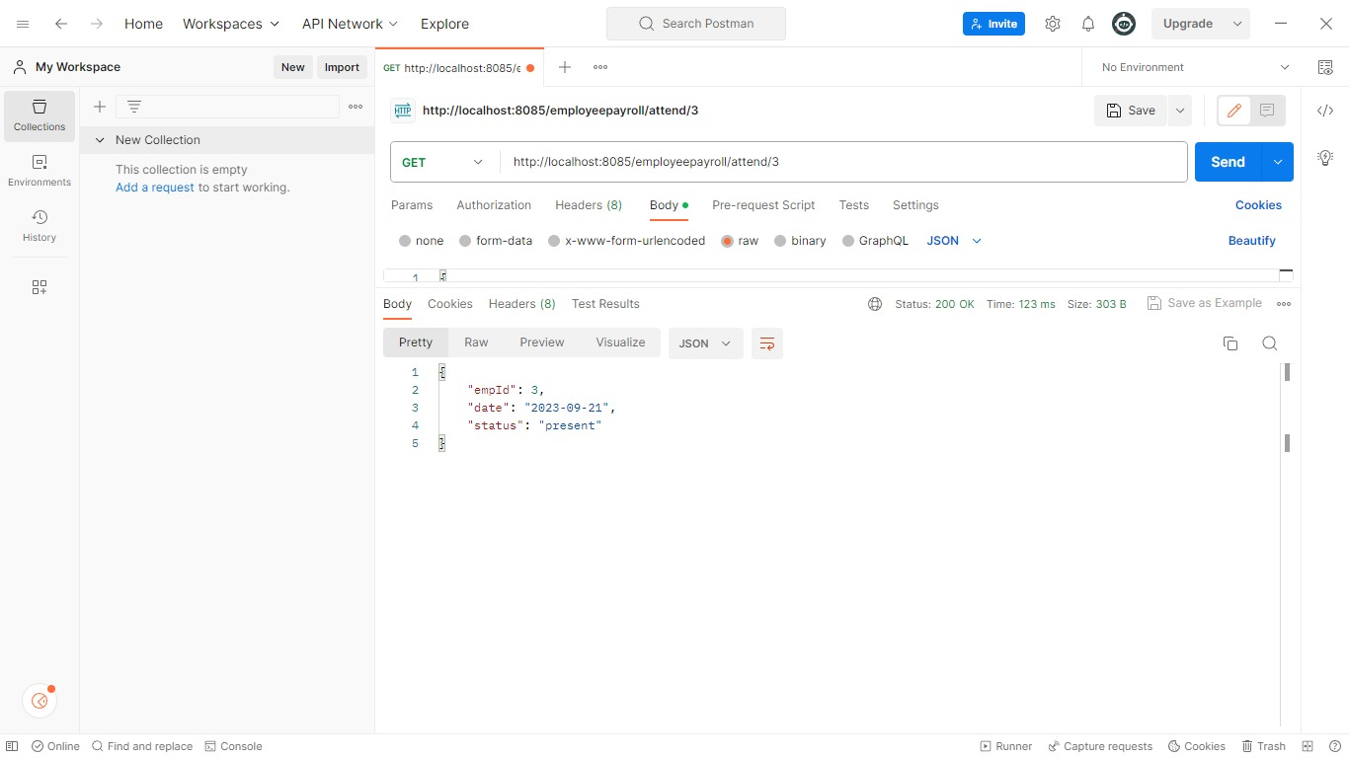

Slide 55
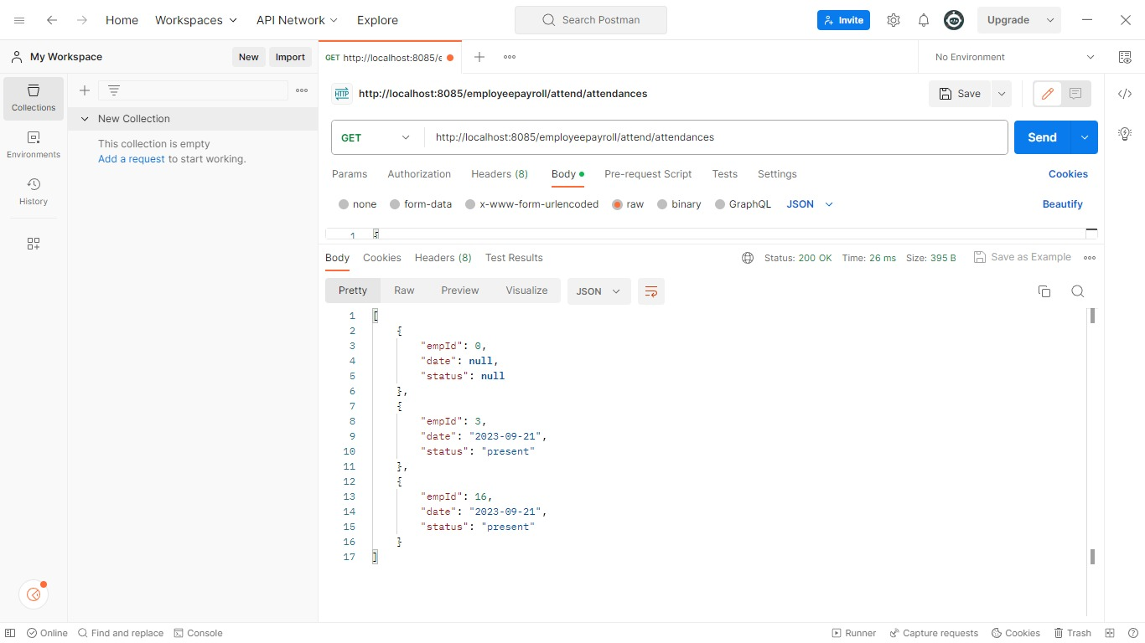

Slide 56
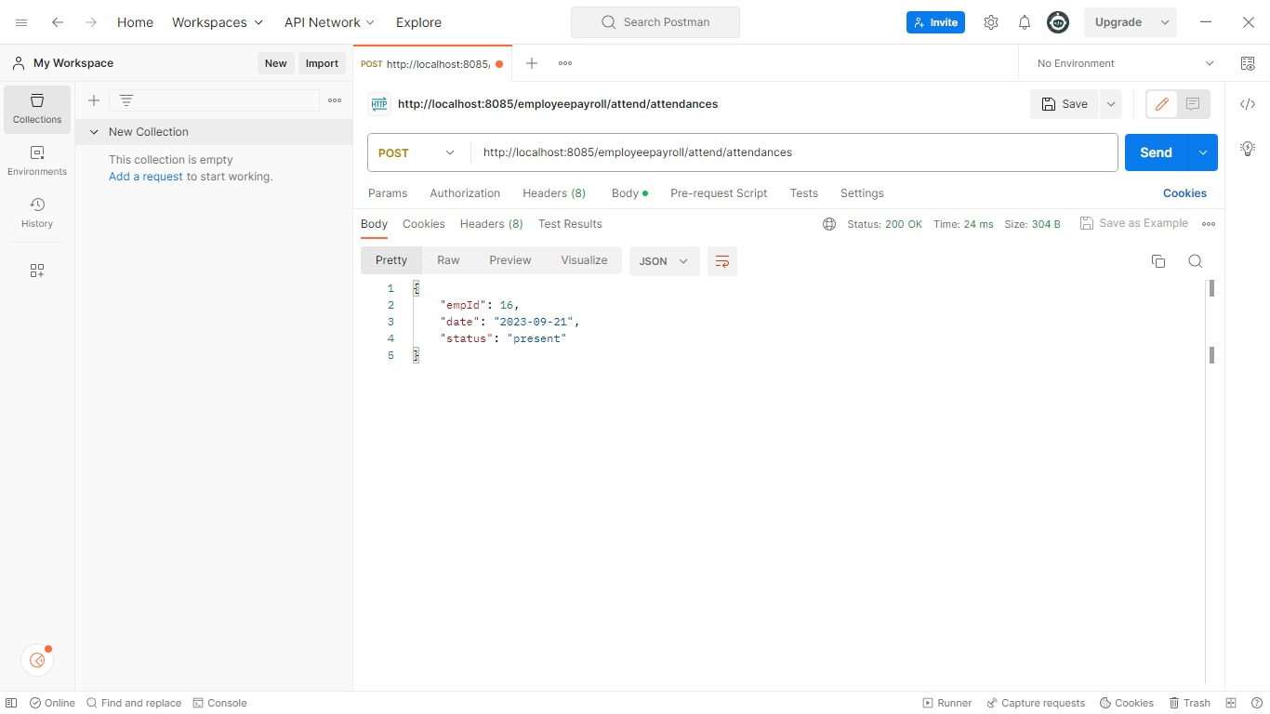

Slide 57
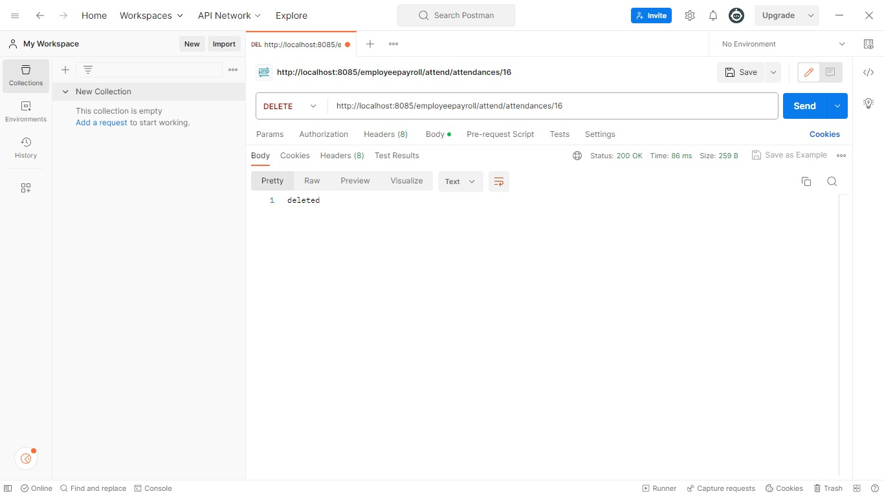

Slide 58

Timesheet

Slide 59
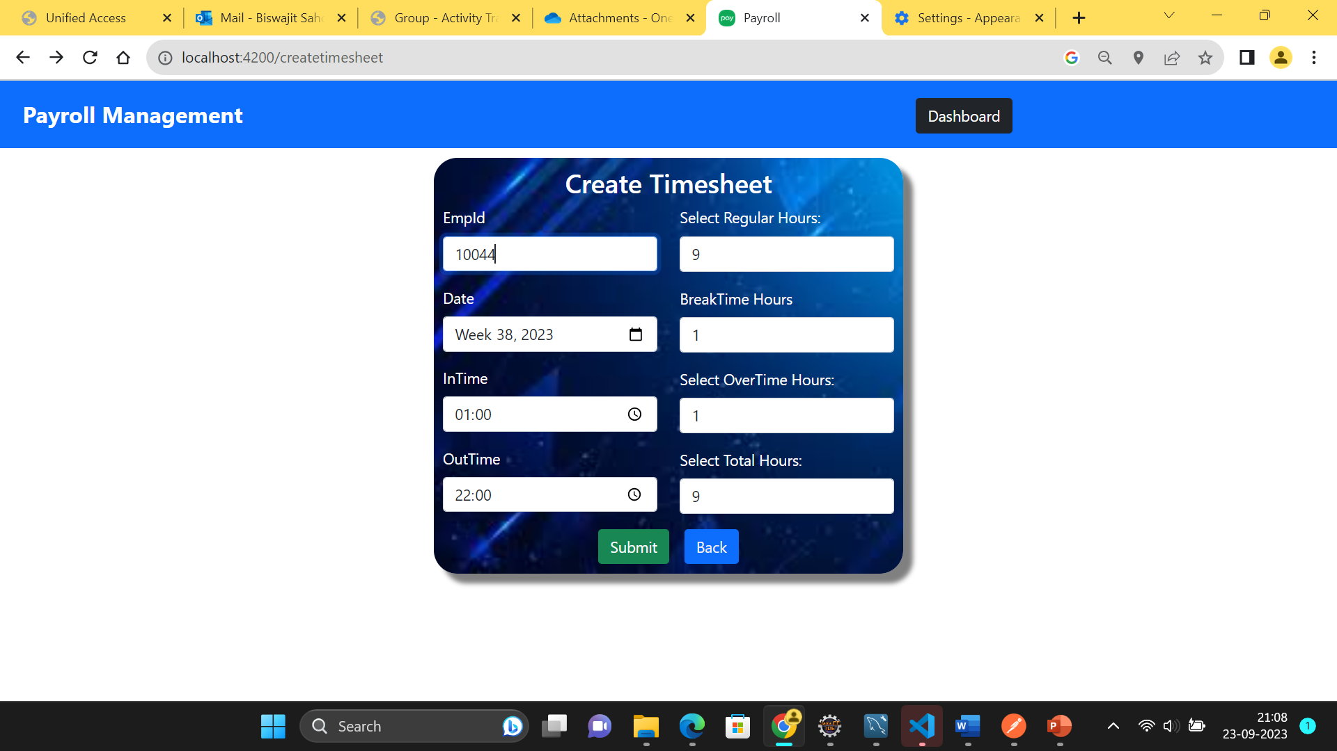
Create Timesheet

Slide 60
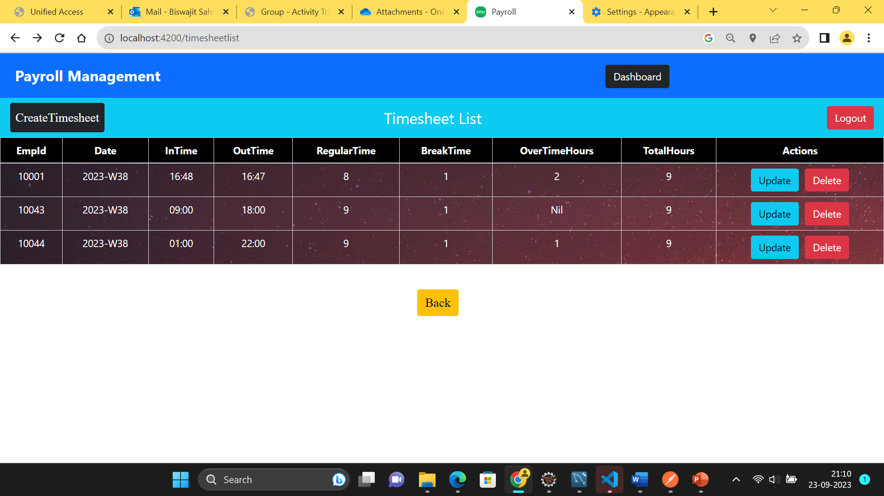
Timesheet List

Slide 61
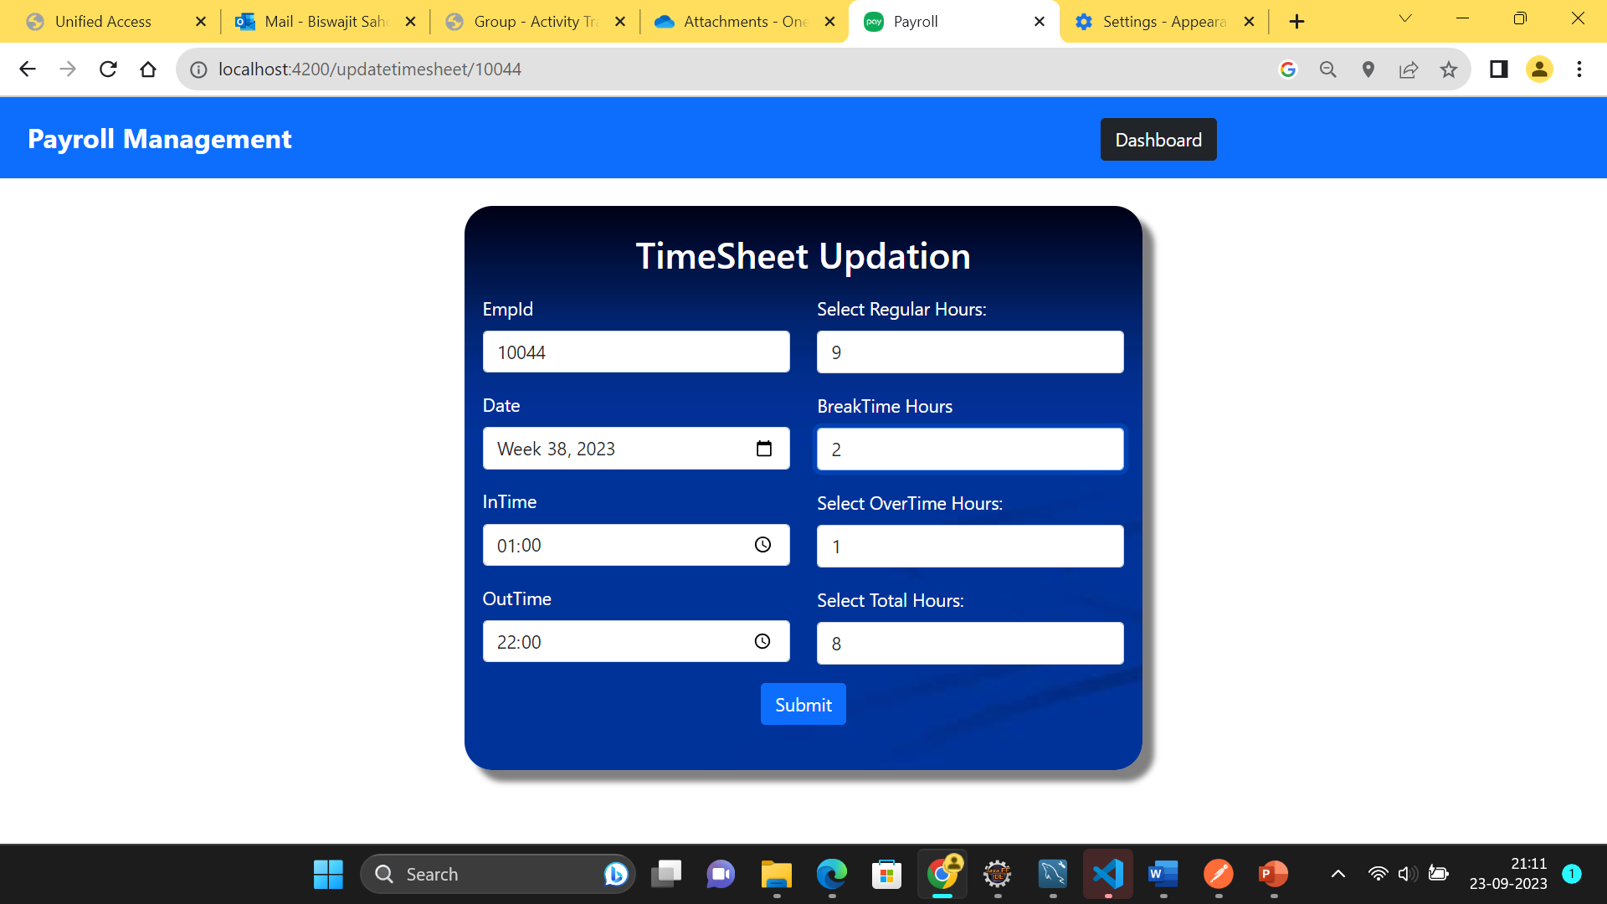
TimeSheet Updation

Slide 62
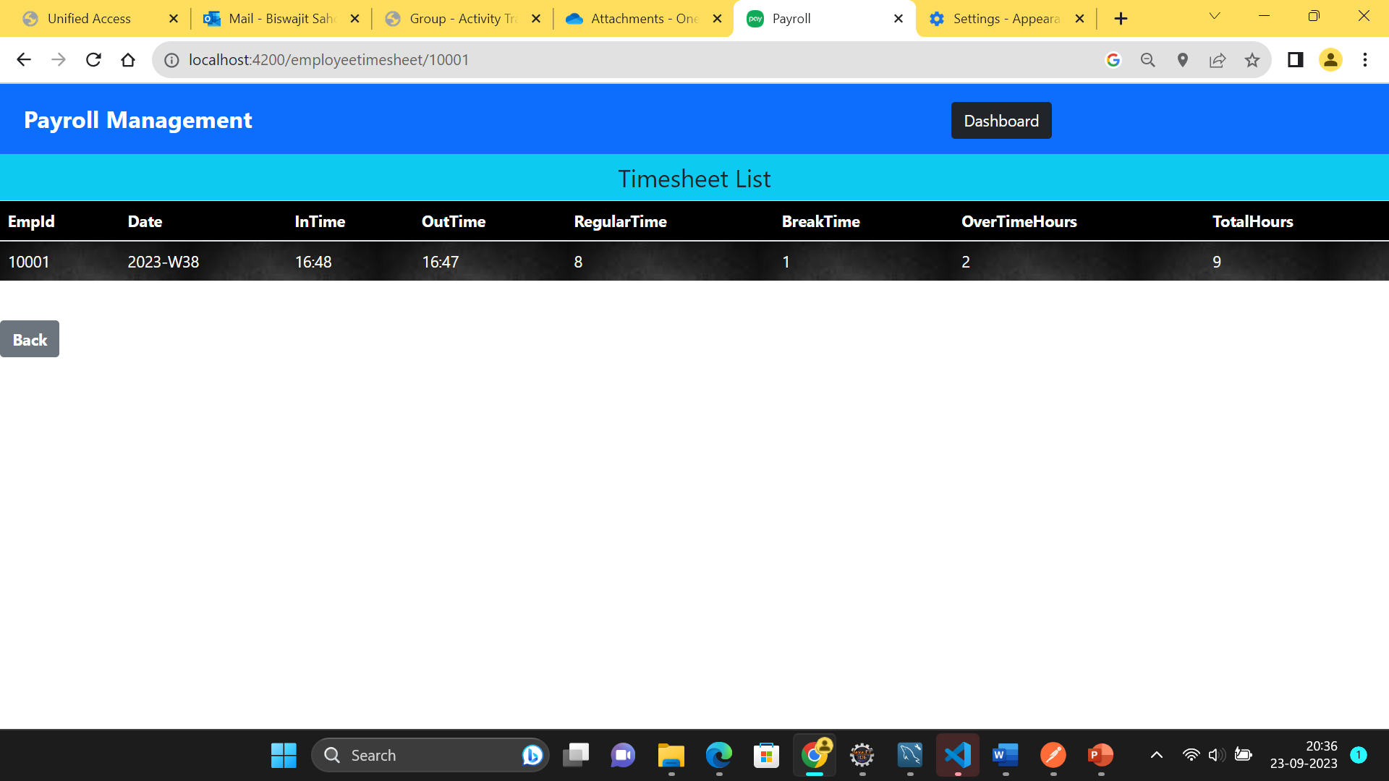
Timesheet List For Particular Employee

Slide 63

TimeSheet Table in Database

Slide 64
Time sheet list APIs
HTTP methods | URL | Operation
GET | http://localhost:8085/employeepayroll/time/timesheets/{empid} | To get the time sheet list of particular employee
GET | http://localhost:8085/employeepayroll/time/timesheets | To get the time sheet list of all the employees
POST | http://localhost:8085/employeepayroll/time/timesheets | To create the time sheet for particular employee
DELETE | http://localhost:8085/employeepayroll/time/timesheet/{empid} | To delete the time sheet for particular employee
PUT | http://localhost:8085/employeepayroll/time/timesheets/{empid} | To update the time sheet for particular employee

Slide 65
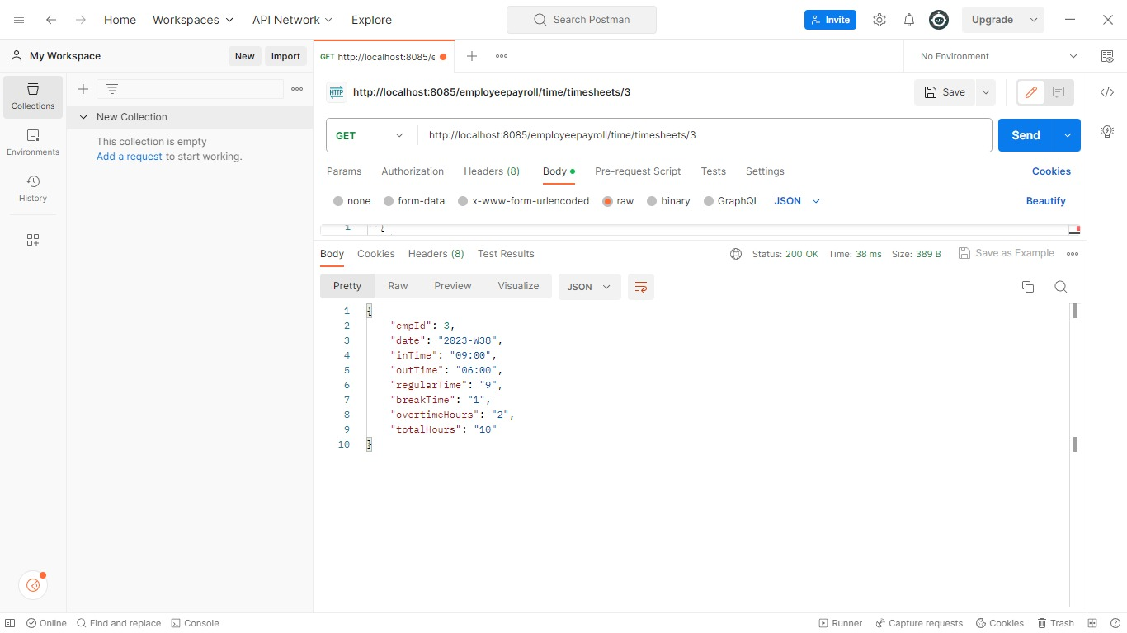

Slide 66
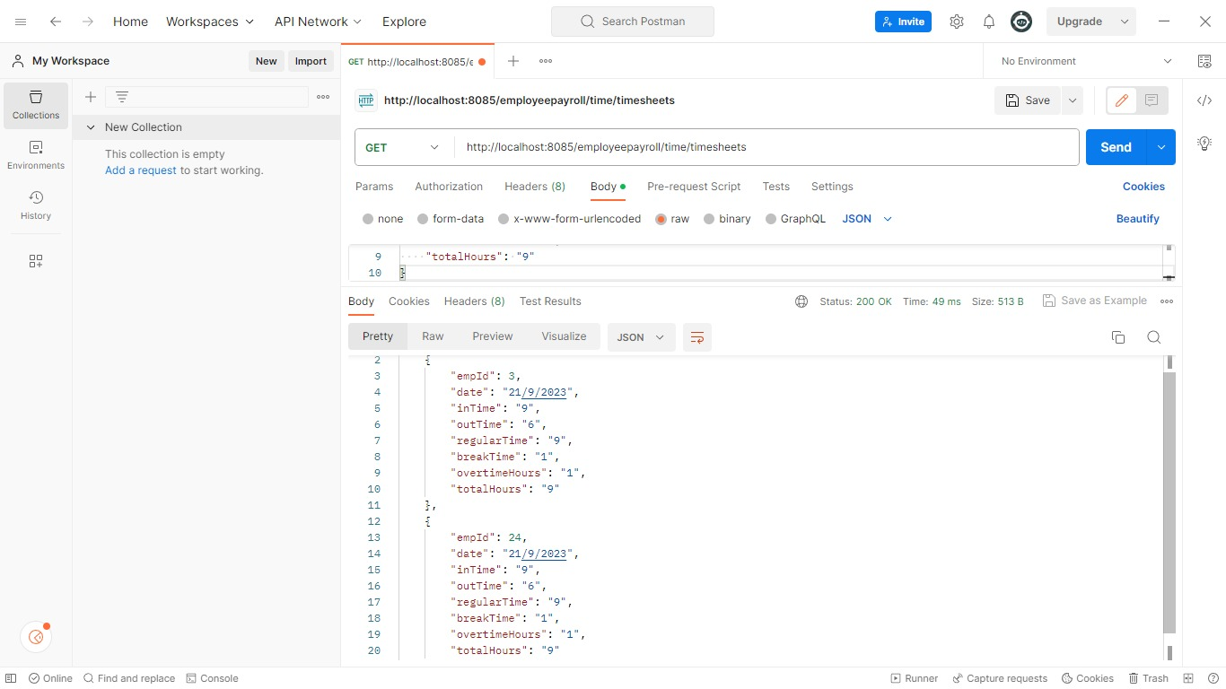

Slide 67
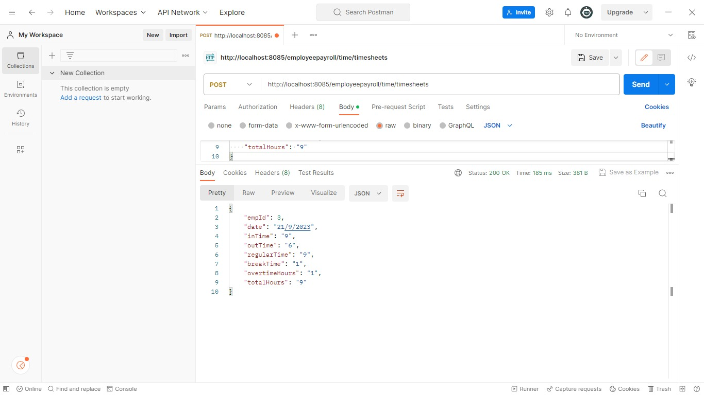

Slide 68
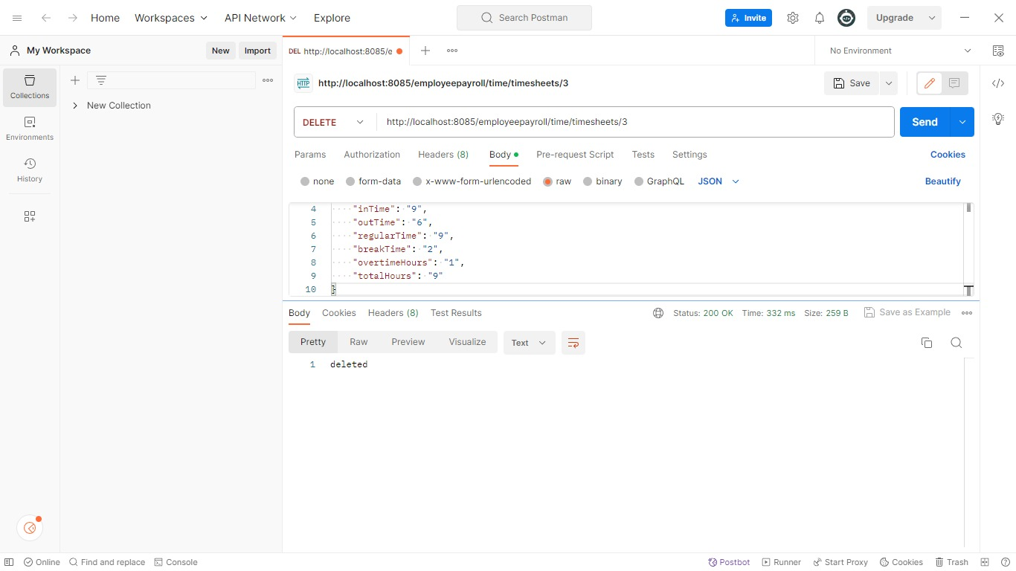

Slide 69
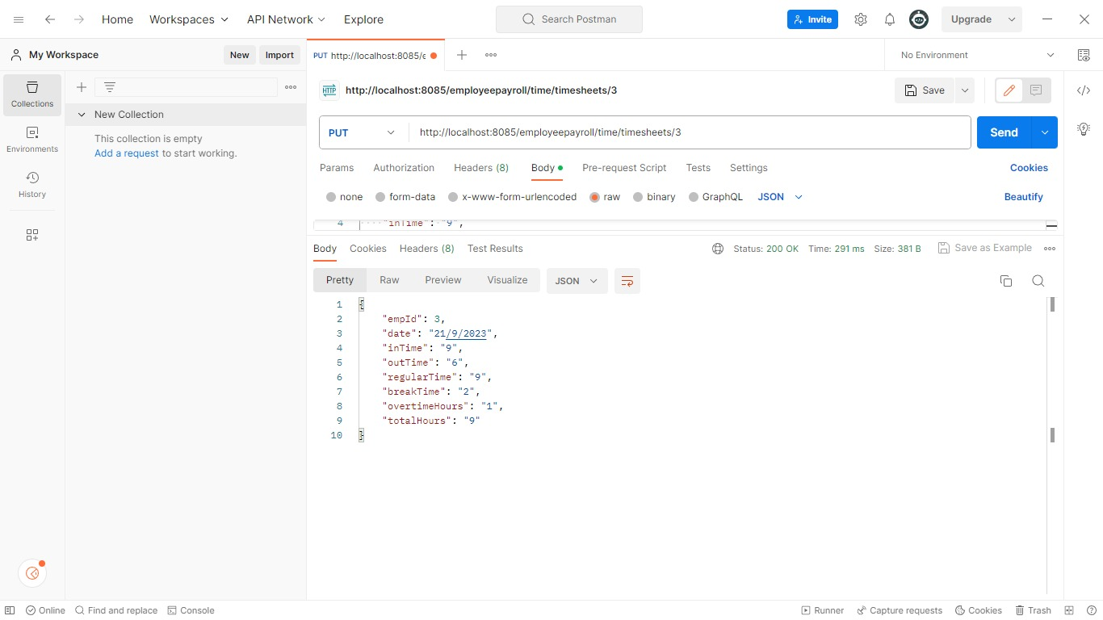

Slide 70

Work Schedule

Slide 71
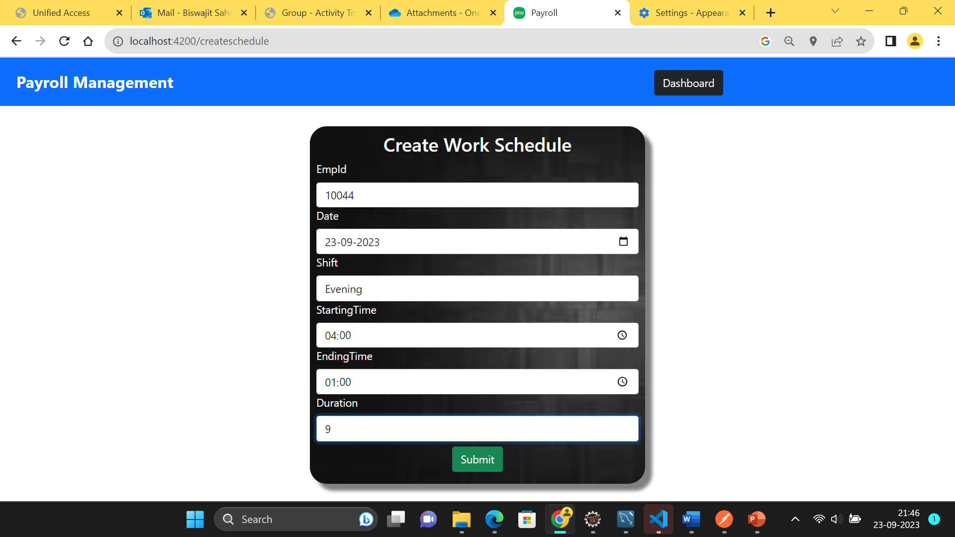
Create Work Schedule

Slide 72
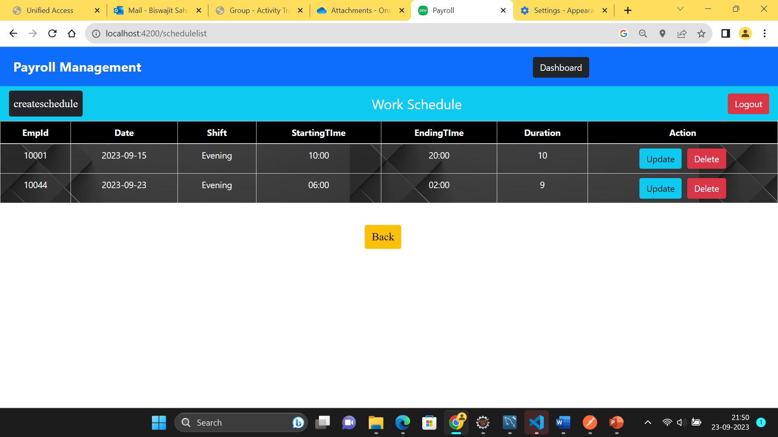
Work Schedule List

Slide 73
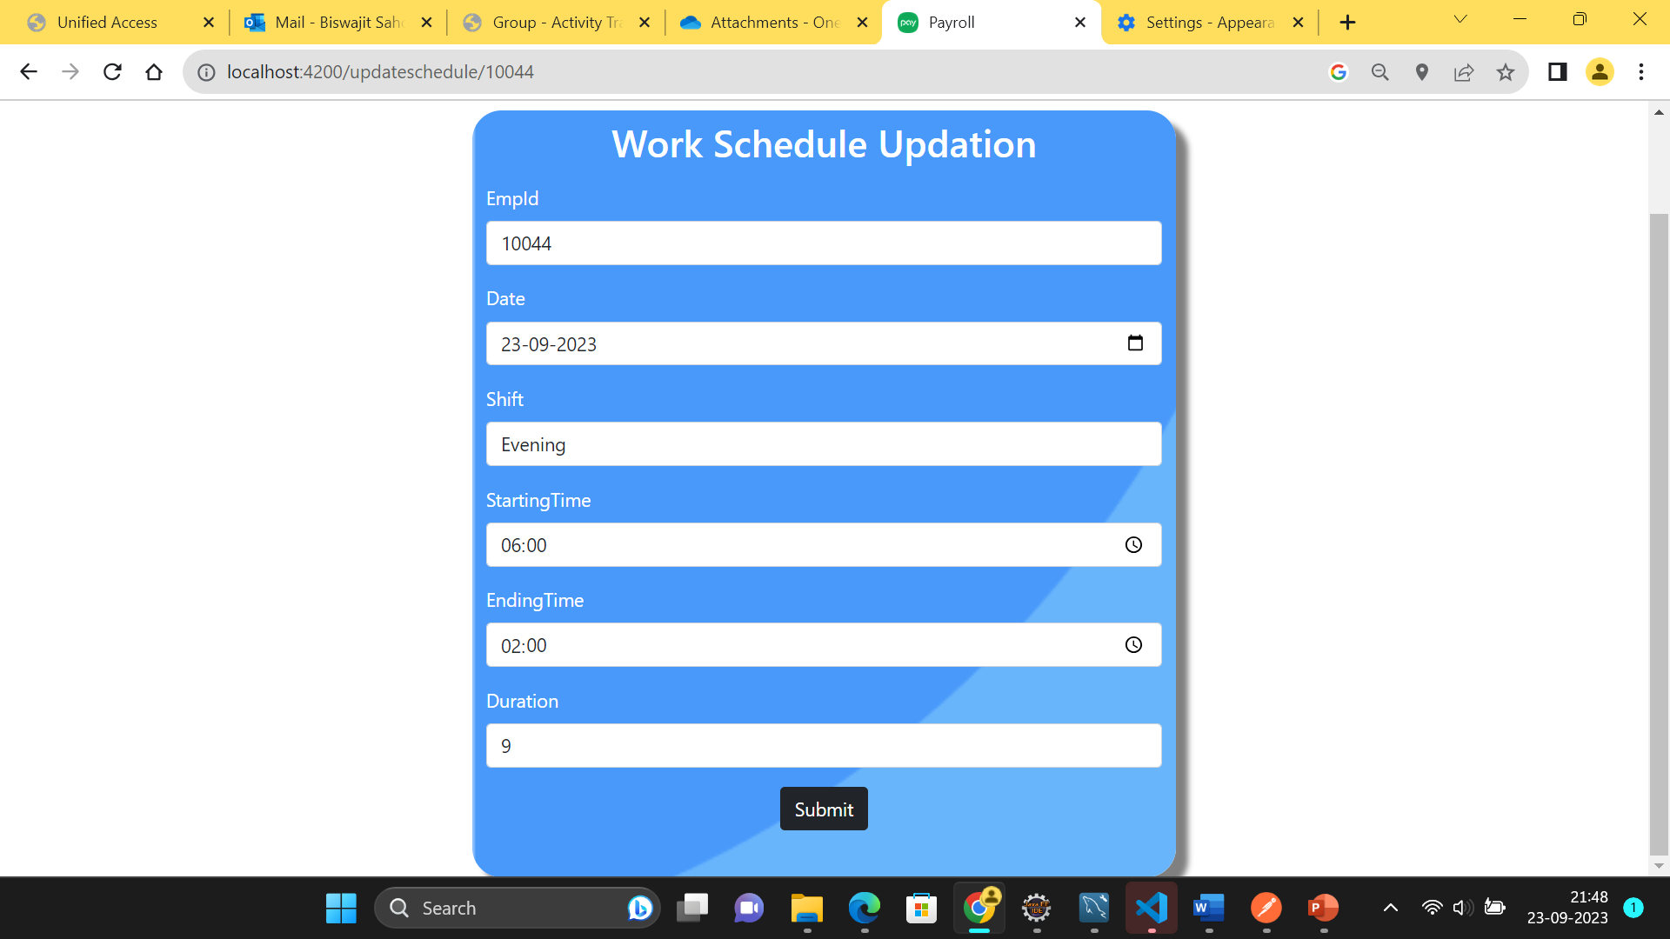
Updation Of Work Schedule

Slide 74

Work Schedule For Particular Employee

Slide 75

Schedule Table In Database

Slide 76
Work Schedule APIs
HTTP methods | URL | Operation
GET | http://localhost:8085/employeepayroll/schedule/schedules/{empid} | To get the work schedule of particular employee
GET | http://localhost:8085/employeepayroll/schedule/schedules | To get the Work schedule of all the employees
POST | http://localhost:8085/employeepayroll/schedule/schedules | To create the Work schedule of particular employee
DELETE | http://localhost:8085/employeepayroll/schedule/schedules/{empid} | To delete the Work schedule of particular employee
PUT | http://localhost:8085/employeepayroll/schedule/schedules/{empid} | To update the Work schedule of particular employee

Slide 77


Slide 78


Slide 79


Slide 80


Slide 81


Slide 82

Leave

Slide 83

Leave List of Employees

Slide 84

Create Leave

Slide 85

Leave

Slide 86

Leave Table In Database

Slide 87
Leave APIs
HTTP methods | URL | Operation
GET | http://localhost:8085/employeepayroll/leave/{empid} | To get the leave list of particular employee
GET | http://localhost:8085/employeepayroll/leave/leaves | To get the leave list of all the employees
POST | http://localhost:8085/employeepayroll/leave/leaves | To create the leave list of particular employee
DELETE | http://localhost:8085/employeepayroll/leave/leaves/{empid} | To delete the leave list of particular employee

Slide 88


Slide 89


Slide 90


Slide 91


Slide 92

Salary

Slide 93

Add Salary

Slide 94

Update Salary

Slide 95

Salary Report

Slide 96

Salary List

Slide 97

Salary Details

Slide 98

Salary Table In Database

Slide 99
Salary list APIs
HTTP methods | URL | Operation
GET | http://localhost:8085/employeepayroll/salary/salaries/{id} | To get the salary list by salary id
GET | http://localhost:8085/employeepayroll/salary/salaries | To return the all the salary list
POST | http://localhost:8085/employeepayroll/salary/salaries | To create the salary list for particular employee
POST | http://localhost:8085/employeepayroll/salary/editsalaries | To edit the salary list for particular employee
DELETE | http://localhost:8085/employeepayroll/salary/salaries/{id} | To delete the salary list for particular employee
GET | http://localhost:8085/employeepayroll/salary/empid/{id} | To get the salary list by employee id

Slide 100


Slide 101


Slide 102


Slide 103


Slide 104


Slide 105


Slide 106

JUnit Testing
JUnit is an open source Unit Testing Framework for JAVA.
It is useful for Java Developers to write and run repeatable tests.
JUnit makes it possible for the software developer to easily correct bugs as they are found.
Once you are done with code, you should execute all tests, and it should pass.
Every time any code is added, you need to re-execute all test cases and makes sure nothing is broken.

Slide 107

JUnit Testing Result

Slide 108

Future scope
This project has many future applications like it can be used in any of the Retail Outlet of Any Type of companies.
This project was build keeping in mind all the requirements of these outlets and they can be implemented in any such type of organization with very few modifications.

Slide 109


Slide 110

Conclusion
“Employee Payroll Management System” is developed to achieve maximum efficiency and reduce the time taken to handle the Payroll activity.
It is designed to replace an existing manual record system thereby reducing time taken for calculations and for storing data.
The implementation of the system in the organization will considerably reduce data entry, time and also provide readily calculated reports.

Slide 111


